Slide 1


We Dare Not Allow Materialism’s Foot in the Door
Why “Integrating the Faith” is outdated and seriously flawed
IMadeThat [CC BY-SA 4.0 (https://creativecommons.org/licenses/by-sa/4.0)]
Barbara S. Helmkamp
May 4, 2019
Notes:
What is Materialism? Methodological Naturalism or Materialism is to Science, as Separation of Church & State is to Government.

Slide 2

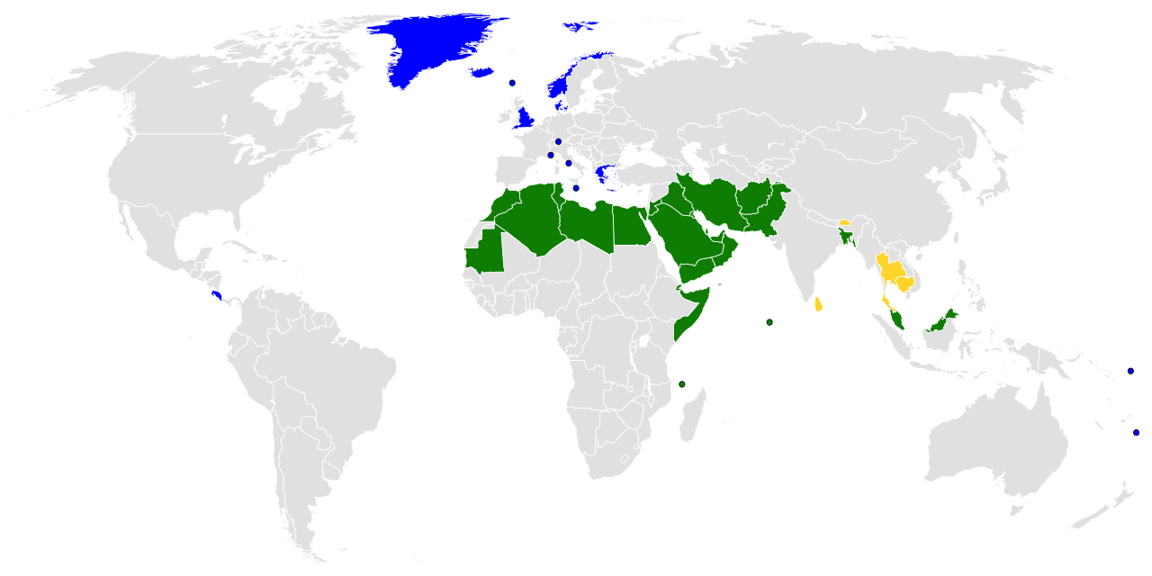
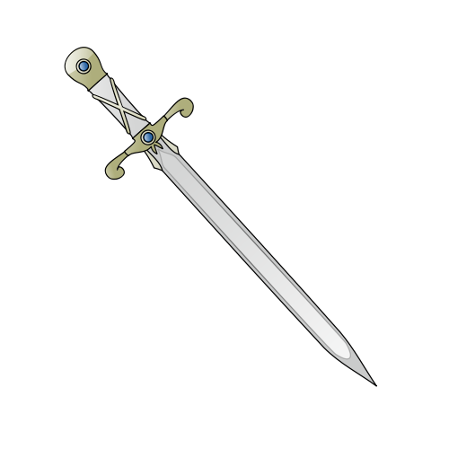
What is Materialism?
Separation of Church & State?
Notes:
Materialism, not in sense of wanting more and more of the stuff money buys, but in sense of having a philosophical commitment to the material world of space & time, matter & energy, being all there is (or operating as though it were).
Map show countries with a state religion.
Separation of Church and State does not mean the Church should be silent. Doctrine of Two Kingdoms, NOT atheism (anti-religion).

Slide 3
Materialism is Anti-Creation
‘Our willingness to accept scientific claims that are against common sense is the key to an understanding of the real struggle between science and the supernatural. We take the side of science in spite of the patent absurdity of some of its constructs, in spite of its failure to fulfill many of its extravagant promises of health and life, in spite of the tolerance of the scientific community for unsubstantiated just-so stories, because we have a prior commitment, a commitment to materialism.
It is not that the methods and institutions of science somehow compel us to accept a material explanation of the phenomenal world, but, on the contrary, that we are forced by our a priori adherence to material causes to create an apparatus of investigation and a set of concepts that produce material explanations, no matter how counter-intuitive, no matter how mystifying to the uninitiated. Moreover, that materialism is absolute, for we cannot allow a Divine Foot in the door… ’
Richard Lewontin, Billions and billions of demons (review of The Demon-Haunted World: Science as a Candle in the Dark by Carl Sagan, 1997), The New York Review, p. 31, 9 January 1997.
Notes:
Science and supernatural are NOT necessarily juxtaposed.
An evolutionary biologist, Prof. Lewontin (b. 1929) pioneered the field of molecular population genetics by merging molecular biology and evolutionary theory, as well as the philosophical and social implications of genetics and evolutionary theory. Among his many books are The Genetic Basis of Evolutionary Change; Biology as Ideology: the Doctrine of DNA; Human Diversity; and The Triple Helix: Gene Organism and Environment.
Next paragraph:
The eminent Kant scholar Lewis Beck used to say that anyone who could believe in God could believe in anything. To appeal to an omnipotent deity is to allow that at any moment the regularities of nature may be ruptured, that Miracles may happen.
[Emphasis in original.]

Slide 4
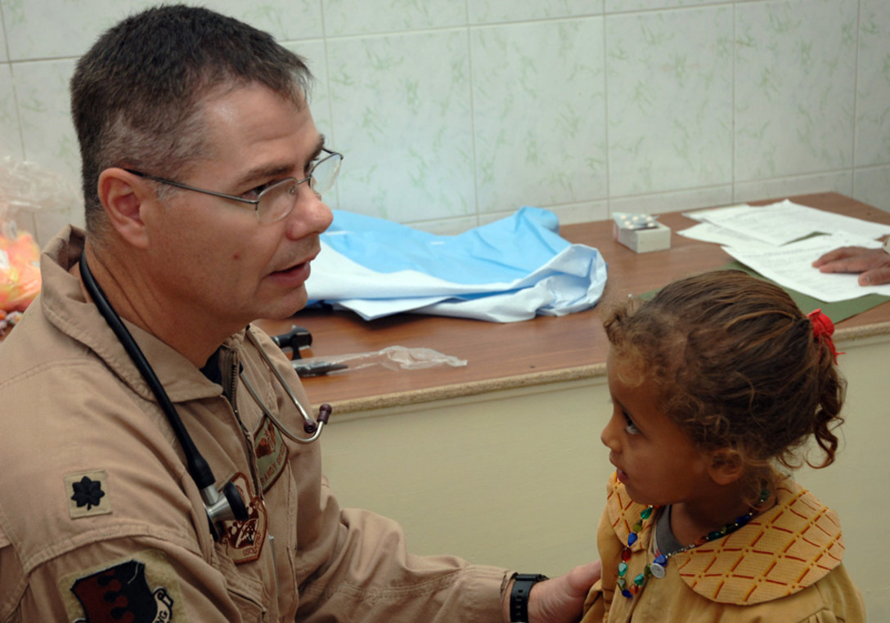
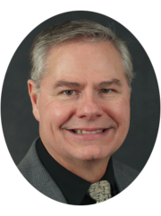
“ ‘Evolution’ is
Anti-Creation.’ ”
BAGHDAD, Iraq U.S. Air Force photo by Master Sgt. Randy L. Mitchell
Dr. Randy Guliuzza has a B.S. Eng. from the S. Dakota School of Mines & Technology, a B.A. in theology from Moody Bible Institute, an M.D. from the Univ. of Minnesota, and a Master of Public Health from Harvard. Dr. Guliuzza served nine years in the Navy Civil Engineer Corps and is a registered Professional Engineer. In 2008, he retired as a lieutenant colonel from the Air Force, where he served as 28th Bomb Wing Flight Surgeon and Chief of Aerospace Medicine. He is the author of Made in His Image: Examining the complexities of the human body; Clearly Seen: Constructing Solid Arguments for Design; Five Minutes with a Darwinist; and Twenty Evolutionary Blunders: Dangers and Difficulties of Darwinian Thinking.
Notes:
‘Evolution’ meaning Darwinism and The Big Bang which are Materialism’s origin “stories” – I’m an not speaking of little “e” evolution meaning merely change over time.
Photo: BAGHDAD, Iraq (AFPN) -- Lt. Col. (Dr.) Randy Guliuzza examines a little girl in a clinic here. The colonel is the 447th chief of aerospace medicine.(U.S. Air Force photo by Master Sgt. Randy L. Mitchell); Randy Guliuzza is a speaker and national rep with ICR.
Quote is from when he spoke at Denver Society of Creation Meeting in Feb 2019

Slide 5
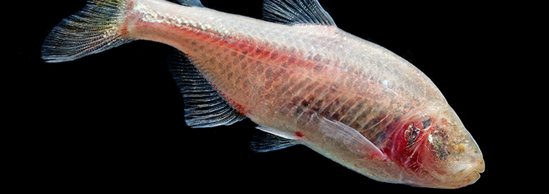
“We need to do biology as though Darwin never existed.”
Natural Selection is NOT why cave fish are blind!
Notes:
Students are not served by untruth, regardless of what ‘Academia’ might espouse. Research is not served by Darwinism, whether medical or engineering! Increasingly it’s clear that natural selection is a myth – that examples biologists might put forward of Evolution is actually adaptation (dynamic genetics): a memorable example given by Dr. Guliuzza is that cave fish lose their sight because they are engineered to lose their eyes when the salinity indicates a cave environment:
Loss of eye tissue in blind cavefish (Astyanax mexicanus), which occurs within a few days of their development, happens through epigenetic silencing of eye-related genes, according to a study led by the National Institutes of Health. Epigenetic regulation is a process where genes are turned off or on, typically in a reversible or temporary manner. This mechanism differs from genetic mutations, which are permanent changes in the DNA code. The study appears in Nature Ecology & Evolution.
Also see: https://www.icr.org/article/blind-cavefish-illuminate-divine-engineering/
Quote is from when he spoke at Denver Society of Creation Meeting in Feb 2019.
Much more is at stake than sight in cave fish; that is, than understanding how it is that cave fish are blind!

Slide 6
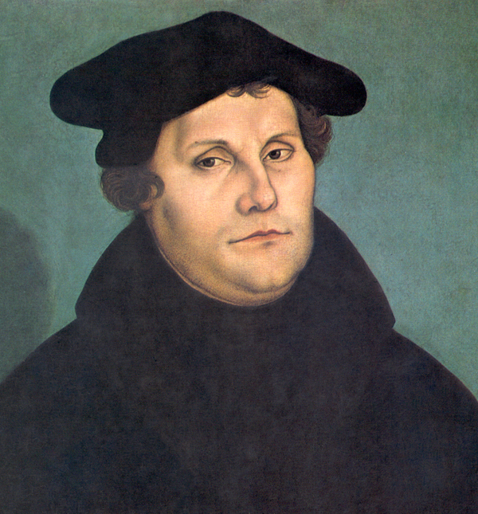
‘Your word is truth’ Jn 17:17
I would advise no one to send his child where the Holy Scriptures are not supreme. Every institution that does not unceasingly pursue the study of God’s word becomes corrupt…. I greatly fear that the universities, unless they teach the Holy Scriptures diligently and impress them on the young students, are wide gates to hell.
Luther’s Works, American Edition (AE), vol. 44, p. 207
Martin Luther (1529)
by Lucas Cranach the Elder
Notes:
John 17:17

Slide 7
Of the Holy Scriptures
We teach that the Holy Scriptures differ from all other books in the world in that they are the Word of God. They are the Word of God because the holy men of God who wrote the Scriptures wrote only that which the Holy Ghost communicated to them by inspiration, 2 Tim. 3:16; 2 Peter 1:21. We teach also that the verbal inspiration of the Scriptures is not a so-called "theological deduction," but that it is taught by direct statements of the Scriptures, 2 Tim. 3:16, John 10:35, Rom. 3:2; 1 Cor. 2:13. Since the Holy Scriptures are the Word of God, it goes without saying that they contain no errors or contradictions, but that they are in all their parts and words the infallible truth, also in those parts which treat of historical, geographical, and other secular matters, John 10:35.
https://www.lcms.org/about/beliefs/doctrine/brief-statement-of-lcms-doctrinal-position#holy-scriptures
Notes:
https://www.lcms.org/about/beliefs/doctrine/brief-statement-of-lcms-doctrinal-position#holy-scriptures
Education is about content, first and foremost. It’s about teaching what is TRUE, about discerning truth from falsehood.
“Other secular matters” - geological, biological, psychological…

Slide 8
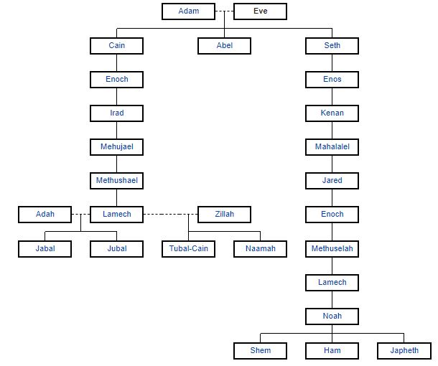
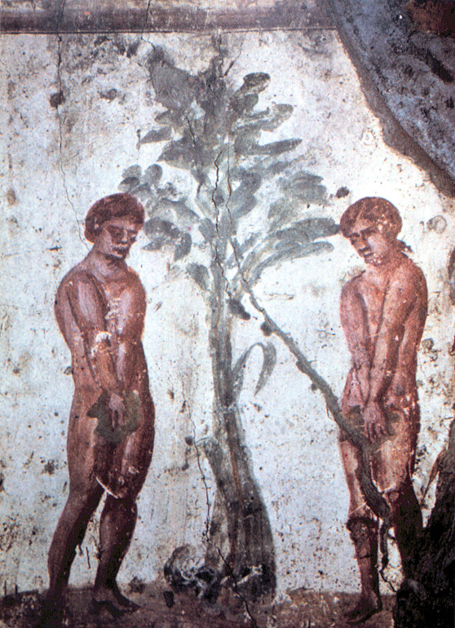
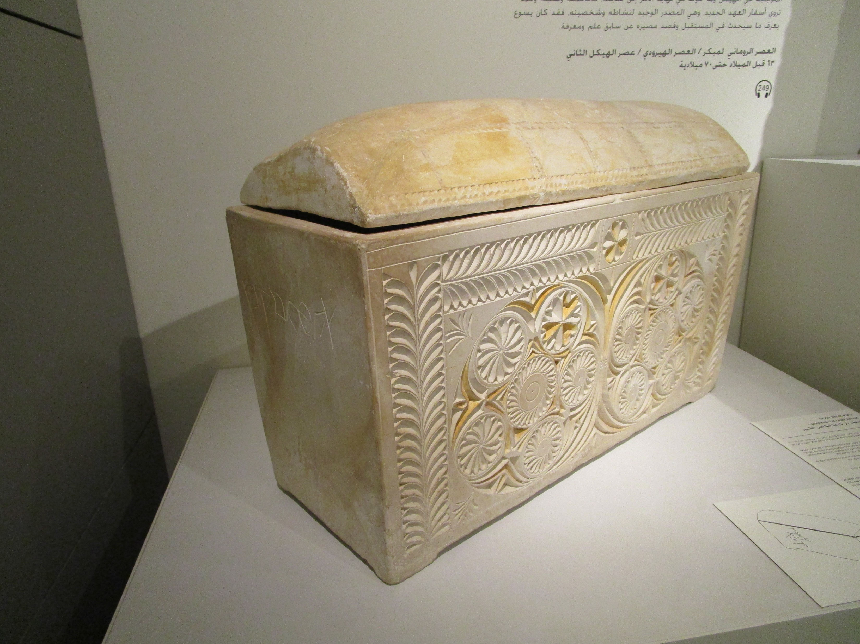
Evolution is Anti-Scriptures
…sin came into the world through one man, and death through sin...” Rom 5:12
Jesus of Nazareth
Notes:
Ossuary of the high priest Joseph, son of Caiaphas, The Israel Museum, Jerusalem: my own photo
Early Christian depiction of Adam and Eve in the Catacombs of Marcellinus and Peter located approx 3 km from southeast Rome and the ancient Via Labicana named for to Christian martyrs who died in the year 304, during the Diocletian persecution

Slide 9
Oh, we handle these poor young people who are committed to us for training and instruction in the wrong way! We shall have to render a solemn account of our neglect to set the word of God before them. Their lot is as described by Jeremiah in Lamentations 2 [:11-12], “My eyes are grown weary with weeping, my bowels are terrified, my heart is poured out upon the ground because of the destruction of the daughter of my people, for the youth and the children perish in all the streets of the entire city. They said to their mothers, ‘Where is bread and wine?’ as they fainted like wounded men in the streets of the city and gave up the ghost on their mothers’ bosom.” We do not see this pitiful evil, how today the young people of Christendom languish and perish miserably in our midst for want of the gospel, in which we ought to be giving them constant instruction and training.
Luther’s Works, American Edition (AE), vol. 44, p. 206
Martin Luther (1529)
by Lucas Cranach the Elder

Slide 10
Oh, we handle these poor young people who are committed to us for training and instruction in the wrong way! We shall have to render a solemn account of our neglect to set the word of God before them. Their lot is as described by Jeremiah in Lamentations…
…We do not see this pitiful evil, how today the young people of Christendom languish and perish miserably in our midst for want of the gospel, in which we ought to be giving them constant instruction and training.
Luther’s Works, American Edition (AE), vol. 44, p. 206
Martin Luther (1529)
by Lucas Cranach the Elder

Slide 11
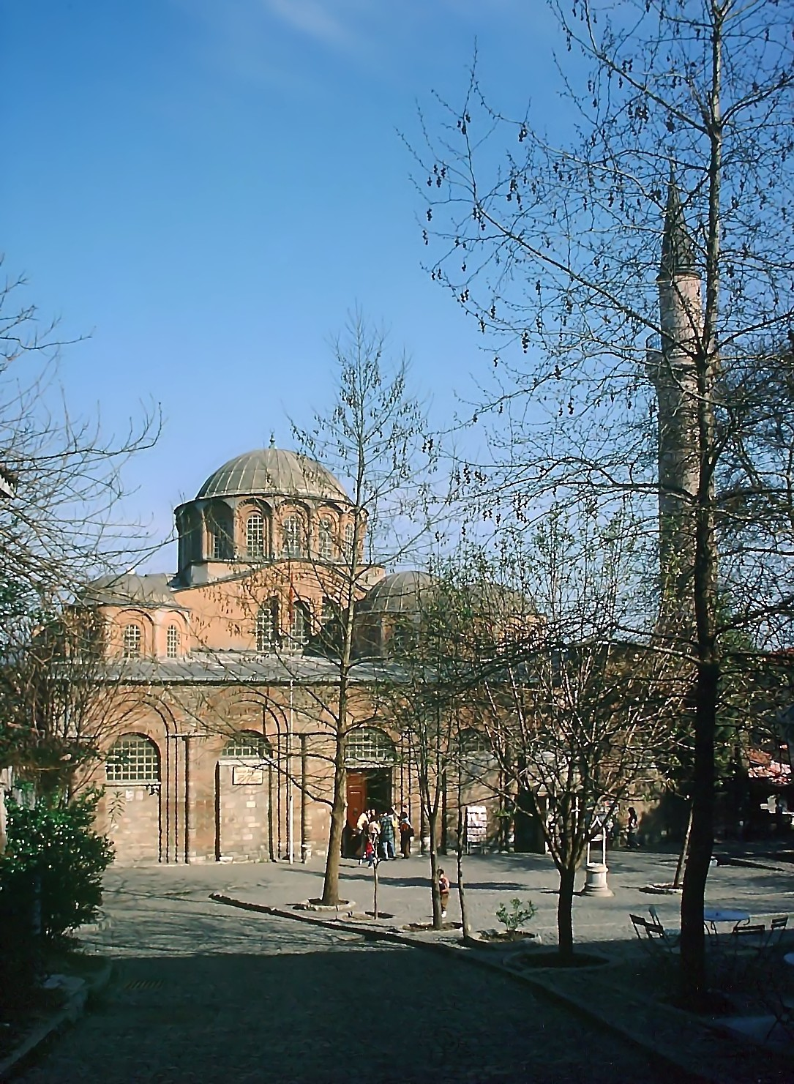
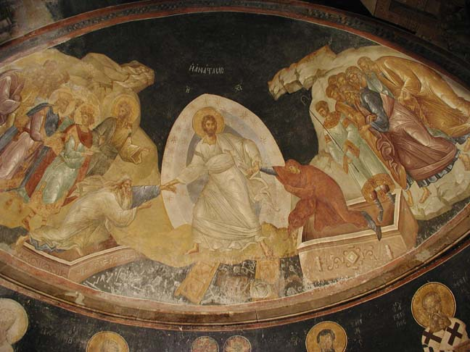
Evolution is Anti-Gospel
…sin came into the world through one man, and death through sin...” Rom 5:12
“…since by a man came death, by a man came also the resurrection from the dead.” 1 Cor 15:21
Raising Adam and Eve, Chora Church, Istanbul, c. 1315
Notes:
This is a pretty shocking statement. Is Evolution (in Darwinian sense) really Anti-Gospel? How so?
Raising Adam and Eve with Satan bound in Hell, Chora Church, Istanbul, c. 1315 – note similarity to Caiaphas ossuary
The Church of the Holy Savior in Chora (Greek: Ἐκκλησία τοῦ Ἁγίου Σωτῆρος ἐν τῇ Χώρᾳ, : Turkish: Kariye Müzesi, Kariye Camii, Kariye Kilisesi) is a medieval Byzantine Greek Orthodox church preserved as the Chora Museum in the Edirnekapi neighborhood of Istanbul is situated in the western part of the municipality or belediye of the Fatih district. In the 16th century, during the Ottoman era, the church was converted into a mosque; it became a museum in 1948. The interior of the building is covered with some of the oldest and finest surviving Byzantine mosaics and frescoes which were uncovered and restored after the building was secularized and turned into a museum.

Slide 12
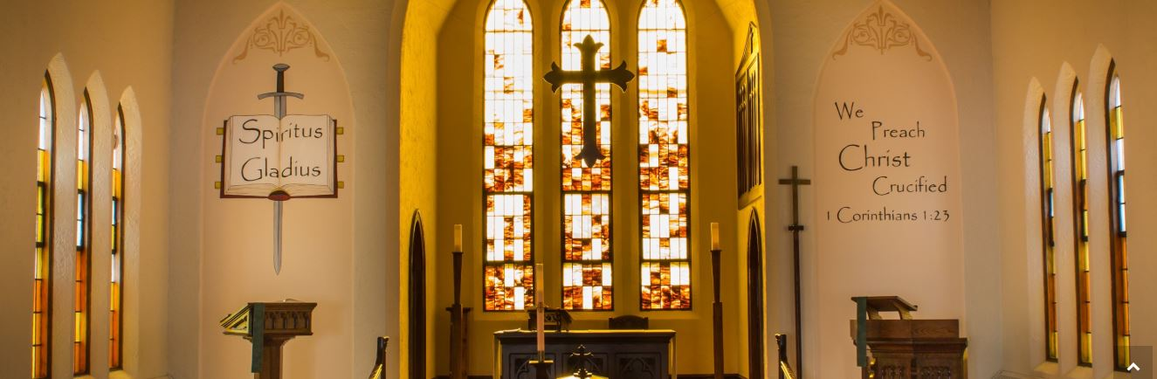
²⁰ Where is the one who is wise? Where is the scribe? Where is the debater of this age? Has not God made foolish the wisdom of the world?... ²³ but we preach Christ crucified, a stumbling block to Jews and folly to Gentiles… 1 Cor. 1
St. Paul’s Lutheran Chapel & University Center, Iowa City
Notes:
We preach (and teach!) Christ crucified.
Spiritus Gladius means sword of the spirit which is the word of God (Eph 6:17)
1 Corinthians 1:20-24 English Standard Version (ESV)
²⁰ Where is the one who is wise? Where is the scribe? Where is the debater of this age? Has not God made foolish the wisdom of the world?²¹ For since, in the wisdom of God, the world did not know God through wisdom, it pleased God through the folly of what we preach^{[a]} to save those who believe. ²² For Jews demand signs and Greeks seek wisdom,²³ but we preach Christ crucified, a stumbling block to Jews and folly to Gentiles, ²⁴ but to those who are called, both Jews and Greeks, Christ the power of God and the wisdom of God.

Slide 13
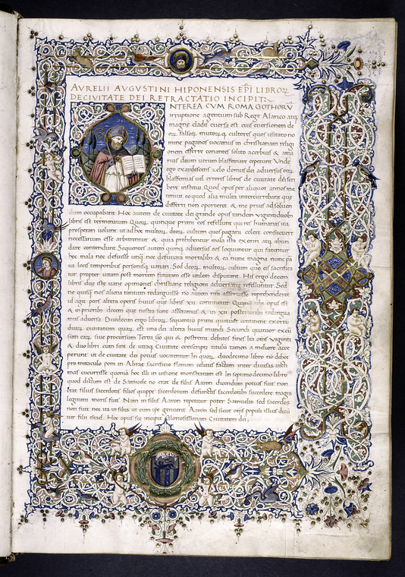
“Integrating the Faith”…. What does this mean?
Integration (n)
in·​te·​gra·​tion | \ ˌin-tə-ˈgrā-shən \
The combining of two or more things so that they work together effectively.
The coordination of mental processes into a normal effective personality, or with the environment.
The operation of finding a function’s anti-derivative or of solving a differential equation.
On the City of God Against the Pagans
Augustine of Hippo
Notes:
City of God manuscript c. 1470: Rome, as the new Babylon vs. the new Jerusalem: the world vs. the church – the City of Man & City of God are not to be integrated, right?
Miriam-Webster Integration (n) in·​te·​gra·​tion | \ ˌin-tə-ˈgrā-shən \ Definition of integration
1: the act or process or an instance of integrating: such as a: incorporation as equals into society or an organization of individuals of different groups (such as races) b: coordination of mental processes into a normal effective personality or with the environment
2a: the operation of finding a function whose differential is known b: the operation of solving a differential equation

Slide 14
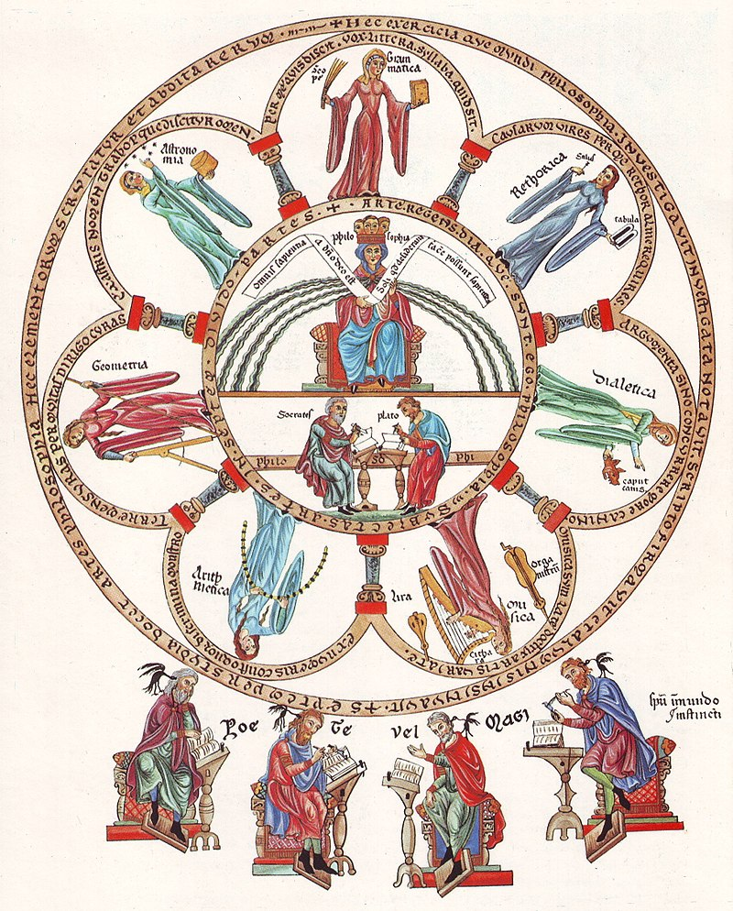
“Integrating the Faith”…. What does this mean?
Integration (n)
in·​te·​gra·​tion | \ ˌin-tə-ˈgrā-shən \
The combining of two or more things so that they work together effectively.
What is being integrated with what?
Faith & Education
Bible & Science (& History & Ethics & Health &…) ?
Christianity & the Mind of the Child ?
Secular textbooks & Lutheran Schools?!
septem artes liberales
Notes:
In the medieval European university the seven liberal arts were grammar, rhetoric, and logic (the trivium) and geometry, arithmetic, music, and astronomy (the quadrivium).
Public Domain: Philosophia et septem artes liberales, the seven liberal arts. From the Hortus deliciarum of Herrad of Landsberg (12th century)

Slide 15
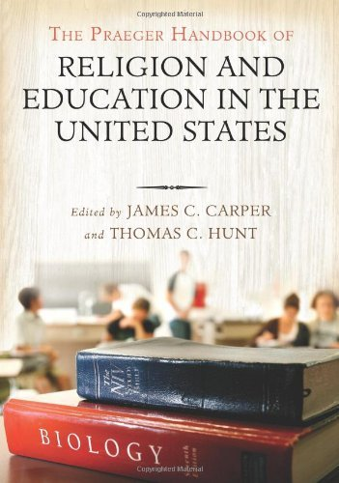
“Integrating the Faith” implies using secular curriculum!
Integration (n)
in·​te·​gra·​tion | \ ˌin-tə-ˈgrā-shən \
The combining of two or more things so that they work together effectively.
Where did this idea come from?
‘Lutheran schools range from “classical” (Latin, logic, rhetoric) to “progressive,” but most would be considered “traditional” and would resemble public schools in curriculum and school structure. Although textbooks are generally secular and commercial, some topics, such as evolution in a science text, would be reviewed critically. Concordia Publishing does provide some textbooks that are specifically Lutheran, but with an LC-MS slant.’
Notes:
So, where did this idea come from?

Slide 16
“Ministers of Religion, Commissioned”
How great a forest is set ablaze by such a small fire! ⁶ And the tongue is a fire, a world of unrighteousness. The tongue is set among our members, staining the whole body, setting on fire the entire course of life, and set on fire by hell. ⁷ For every kind of beast and bird, of reptile and sea creature, can be tamed and has been tamed by mankind,⁸ but no human being can tame the tongue. It is a restless evil, full of deadly poison. ⁹ With it we bless our Lord and Father, and with it we curse people who are made in the likeness of God. ¹⁰ From the same mouth come blessing and cursing. My brothers, these things ought not to be so. ¹¹ Does a spring pour forth from the same opening both fresh and salt water? ¹² Can a fig tree, my brothers, bear olives, or a grapevine produce figs? Neither can a salt pond yield fresh water. ¹³ Who is wise and understanding among you?
James 3 (ESV)
3 Not many of you should become teachers, my brothers, for you know that we who teach will be judged with greater strictness. ² For we all stumble in many ways. And if anyone does not stumble in what he says, he is a perfect man, able also to bridle his whole body. ³ If we put bits into the mouths of horses so that they obey us, we guide their whole bodies as well. ⁴ Look at the ships also: though they are so large and are driven by strong winds, they are guided by a very small rudder wherever the will of the pilot directs. ⁵ So also the tongue is a small member, yet it boasts of great things.
Notes:
The Mid-South District of The Lutheran Church--Missouri Synod
Calling a Lutheran School Teacher:
The Holy Spirit guides and directs the process of calling workers in His kingdom through people, on behalf of calling entities according to their constitutional process. Each step of the process will always include prayer that God’s will be done and that the Holy Spirit guides the process and decisions. A Call comes from God through the calling entity and is extended by God to the called person.
Who may be a Lutheran School Teacher?
One who is “called”- Preferred The Lutheran Church--Missouri Synod classifies teachers and administrators as “Minister of Religion, Commissioned.” Such a person has [a] graduated from a synodical college following a synodically prescribed course of study or [b] completed a course of study making her/him eligible for a colloquy. A “colloquy” is an on-line, eight-course academic program offered by the Concordia University System for teachers who have not graduated from a synodical college, are at least 25 years of age, and have been a member of an LCMS congregation for at least two years. One who is “contracted” - Allowed If a congregation or association is not successful in having a call for the principalship accepted by an individual, the congregation or association may contract for those services. In that case, the formal call procedures are not required, but the steps outlined in this document may still be valuable to the search committee.

Slide 17

Meyer v. Nebraska (1923)
On April 9, 1919, Nebraska enacted a statute, known as the Siman Act that imposed restrictions on both the use of a foreign language as a medium of instruction and on foreign languages as a subject of study.
Regarding the latter, it provided that "No person, individually or as a teacher, shall, in any private, denominational, parochial or public school, teach any subject to any person in any language other than the English language."
Regarding foreign-language education, it prohibited instruction of children who had yet to successfully complete the eighth grade.
On May 25, 1920, Robert T. Meyer, while an instructor in Zion Parochial School, a one-room schoolhouse in Hampton, NE, taught the subject of reading in the German language (using a Bible) to 10-year-old Raymond Parpart, a fourth-grader.
The Hamilton County Attorney entered the classroom and discovered Parpart reading from the Bible in German. He charged Meyer with violating the Siman Act. Meyer was tried and convicted in the Hamilton County district court.
Meyer appealed to the Supreme
Court and won. His lead attorney was
Arthur Mullen, an Irish Catholic.
Notes:
WWI witnessed an extensive campaign against all things German, such as the performance of German music at symphony concerts and the meetings of German-American civic associations. Language was a principal focus of legislation at the state and local level. It took many forms, from requiring associations to have charters written in English to a ban on the use of German within the town limits. Some states banned foreign language instruction, while a few banned only German. Some extended their bans into private instruction and even to religious education. A bill to create a Department of Education at the federal level was introduced in October 1918, designed to restrict federal funds to states that enforced English-only education. An internal battle over conducting services and religious instruction in German divided the Lutheran churches.^{[2]}
On April 9, 1919, Nebraska enacted a statute called "An act relating to the teaching of foreign languages in the state of Nebraska", commonly known as the Siman Act. It imposed restrictions on both the use of a foreign language as a medium of instruction and on foreign languages as a subject of study. With respect to the use of a foreign language while teaching, it provided that "No person, individually or as a teacher, shall, in any private, denominational, parochial or public school, teach any subject to any person in any language other than the English language." With respect to foreign-language education, it prohibited instruction of children who had yet to successfully complete the eighth grade.
On May 25, 1920, Robert T. Meyer, while an instructor in Zion Parochial School, a one-room schoolhouse in Hampton, NE, taught the subject of reading in the German language to 10-year-old Raymond Parpart, a fourth-grader. The Hamilton County Attorney entered the classroom and discovered Parpart reading from the Bible in German. He charged Meyer with violating the Siman Act.
Meyer was tried and convicted in the district court for Hamilton County, was and fined $25 USD (about $313 in 2018 dollars). The Nebraska Supreme Court affirmed his conviction by a vote of 4 to 2. The majority thought the law a proper response to "the baneful effects" of allowing immigrants to educate their children in their mother tongue, with results "inimical to our own safety". The dissent called the Siman Act the work of "crowd psychology".
Meyer appealed to the Supreme Court of the United States. His lead attorney was Arthur Mullen, an Irish Catholic and a prominent Democrat, who had earlier failed in his attempt to obtain an injunction against enforcement of the Siman Act from the Nebraska State Supreme Court. Oral arguments expressed conflicting interpretations of the World War I experience. Mullen attributed the law to "hatred, national bigotry and racial prejudice engendered by the World War". Opposing counsel countered that "it is the ambition of the State to have its entire population 100 per cent. American".
In Meyer v. Nebraska, 262 U.S. 390 (1923) the Supreme Court invalidated a Nebraska law banning the teaching of foreign languages to schoolchildren, finding that the law violated the Fourteenth Amendment’s due process clause. The Meyer law sprang from the nativist sentiment fostered by World War I. The Court recognized a liberty interest in parents providing an education for their children, and found that the law infringed on that interest without a proper “police power” rationale.
In this case, Robert Meyer, a teacher at Zion Parochial School, was charged with violating the state law by teaching German to a student. Nebraska had claimed that the law was a proper means to “promote civic development by inhibiting training and education of the immature in foreign tongues and ideals before they could learn English and acquire American ideals.” The Court, while acknowledging the importance of ensuring that children attain proficiency in English, concluded in a majority opinion by Justice James C. McReynolds that “the statute as applied is arbitrary and without reasonable relation to any end within the competency of the state.” He added that “mere knowledge of the German language cannot reasonably be regarded as harmful.”

Slide 18

By the late 1800s, the SNJM had established schools in Seattle and Spokane. In 1893 they received a state charter to confer baccalaureate degrees, enabling the establishment of St. Mary’s College, the first liberal arts college for women in the Pacific Northwest. In 1906, they purchased property near Oswego, OR, to be used for the college and a home for orphans. In addition, during the next few years they opened normal schools in Spokane, Seattle and Marylhurst to provide teacher training and certification.
In the 1920s SNJM boycotted businesses supporting the KKK from which tensions rose, leading to passage of the 1922 Oregon Compulsory [Public] School. The SNJM together with Hill Military Academy challenged the law and took their case to the U.S. Supreme Court, which ruled in their favor in this landmark decision. By striking down the law as unconstitutional, the court cleared the way for parents to choose where and how to educate their children.
Pierce v. Society of Sisters (1925)
Justice James C. McReynolds said the state had no power to ‘standardize its children by forcing them to accept instruction from public teachers only. The child is not the mere creature of the State; those who nurture him and direct his destiny have the right, coupled with the high duty, to recognize and prepare him for additional obligations.’
Notes:
The Supreme Court decision in Pierce v. Society of Sisters, 268 U.S. 510 (1925), although never directly mentioning the First Amendment, has become an important precedent both for the rights of parents to educate their children and for the rights of parochial schools to operate alongside public schools. Pierce demonstrates how the Court often relied on property rights before it applied First Amendment rights to the states via the Fourteenth Amendment.
Oregon had adopted an initiative providing the Compulsory Education Act, which required most children to attend public schools through the age of sixteen years. The act had been challenged by the Society of Sisters and by the Hill Military Academy, both of which had previously provided such education on their own and which now faced declining enrollments as a result of the law.
Justice James C. McReynolds wrote the Court’s unanimous decision upholding a lower court ruling that had decided that the law deprived the school owners of their property without due process of law and interfered with the liberty of parents to choose schools for their children. Citing Meyer v. Nebraska (1923), which dealt with instruction in foreign languages, for the principle that parents could “direct the upbringing and education of children under their control,” McReynolds said the state had no power to “standardize its children by forcing them to accept instruction from public teachers only. The child is not the mere creature of the State; those who nurture him and direct his destiny have the right, coupled with the high duty, to recognize and prepare him for additional obligations.” Acknowledging that the state had a general right to adopt legislation that affects patrons of businesses, McReynolds observed that “the injunctions here sought are not against the exercise of any proper power. Plaintiffs asked protection against arbitrary, unreasonable and unlawful interference with their patrons and the consequent destruction of their business and property.” The case is sometimes cited as one that set the stage for the right of privacy.
As the Oregon mission grew, Sisters traveled north to establish Holy Names schools in Seattle (and later, Spokane). There was rejoicing in 1893 when they received a state charter to confer baccalaureate degrees, enabling the establishment of St. Mary’s College, the first liberal arts college for women in the Pacific Northwest. In 1906, the Sisters purchased property near Oswego, OR to be used for the college and a home for orphans. In addition, during the next few years they opened normal schools in Spokane, Seattle and Marylhurst to provide teacher training and certification. 1911 marked the dedication of the Convent of the Holy Names in Marylhurst – a name the Sisters created from the name of Mary, mother of Jesus, and hurst, meaning woods.
Bigotry reared its head in the 1920s. Mother Mary Flavia informed businesses supporting the Ku Klux Klan of a boycott by the Sisters. Tensions rose, leading to passage of the 1922 Oregon Compulsory School Law that required children to attend public schools. The Sisters challenged the law and took their case to the U.S. Supreme Court, which ruled in their favor in the landmark 1925 decision Pierce vs. Society of Sisters. By striking down the law as unconstitutional, the court cleared the way for parents to choose where and how to educate their children.

Slide 19
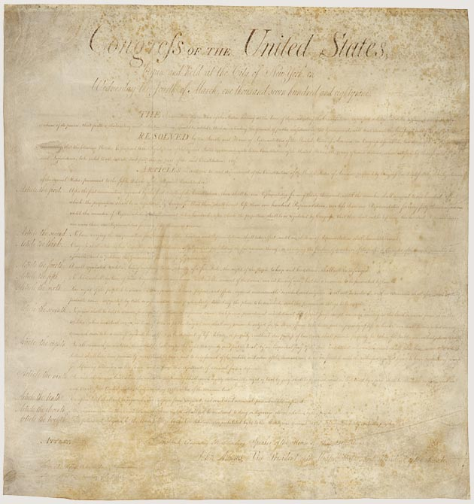
Bill of Rights (1791)
Amendment I
Congress shall make no law respecting an establishment of religion, or prohibiting the free exercise thereof; or abridging the freedom of speech, or of the press; or the right of the people peaceably to assemble, and to petition the government for a redress of grievances.
If not operating by fear,
just might we do better?
Notes:
From Declaration of Independence: “We hold these truths to be self-evident, that all men are created equal, that they are endowed by their Creator with certain unalienable Rights…”
On September 25, 1789, the First Congress of the United States proposed 12 amendments to the Constitution. The 1789 Joint Resolution of Congress proposing the amendments is on display in the Rotunda in the National Archives Museum. Ten of the proposed 12 amendments were ratified by three-fourths of the state legislatures on December 15, 1791. The ratified Articles (Articles 3–12) constitute the first 10 amendments of the Constitution, or the U.S. Bill of Rights. In 1992, 203 years after it was proposed, Article 2 was ratified as the 27th Amendment to the Constitution. Article 1 was never ratified.

Slide 20
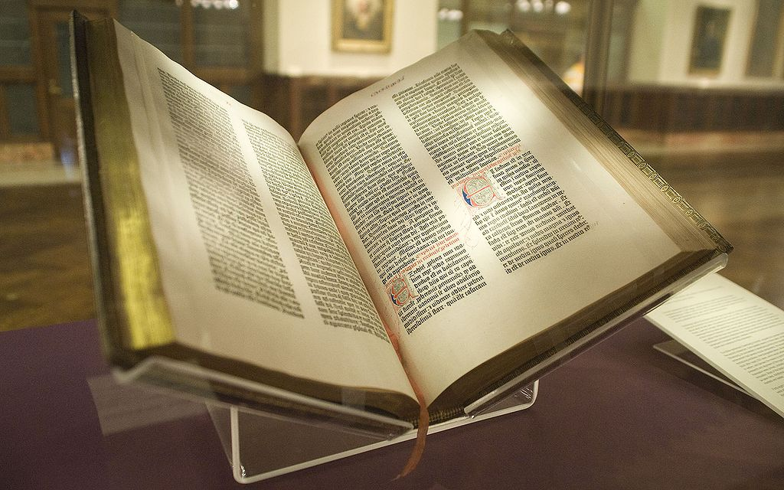


What makes an Education Christian?
NYC Wanderer: [CC BY-SA 2.0]
‘Whatever is true, whatever is honorable, whatever is just, whatever is pure, whatever is lovely, whatever is commendable…’ Php. 4:8 (ESV)
Notes:
Two authorities in the classroom: Christian teacher + Christian materials (norm for what is true, good & beautiful being the Scriptures)
Gutenberg Bible of the New York Public Library. Bought by James Lenox in 1847, it was the first copy to be acquired by a United States citizen.

Slide 21
What makes a Curriculum Christian?
NYC Wanderer: [CC BY-SA 2.0]
‘Behold, I am sending you out as sheep in the midst of wolves, so be wise as serpents and innocent as doves.’ Matt. 10:16
Notes:
Discerning what is true over against what is untrue. Reference Dorothy Sayers: Lost Tools of Learning on trivium in relation to developmental stages of learning
Gutenberg Bible of the New York Public Library. Bought by James Lenox in 1847, it was the first copy to be acquired by a United States citizen.

Slide 22
Surely, Christian teachers at Christian schools would want Christian textbooks?
Objection #1:
“Christian textbooks are not necessary because we prefer to Integrate the Faith using secular textbooks, like we have always done.”

Slide 23
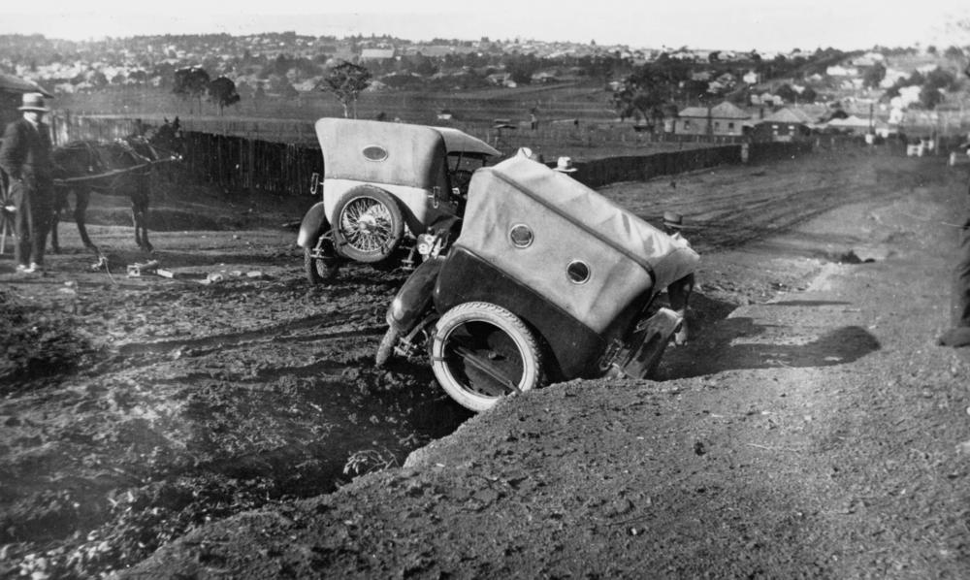
Surely, Christian teachers at Christian schools would want Christian textbooks?
Notes:
Stuck in a deep rut on the outskirts of Toowoomba, ca.1925 (Public Domain: State Library of Queensland Australia)

Slide 24
Surely, Christian teachers at Christian schools would want Christian textbooks?
Objection #2:
“Many Christian publishers promote non-Lutheran theology so it’s better to use secular textbooks and thereby avoid theological conflict.”

Slide 25
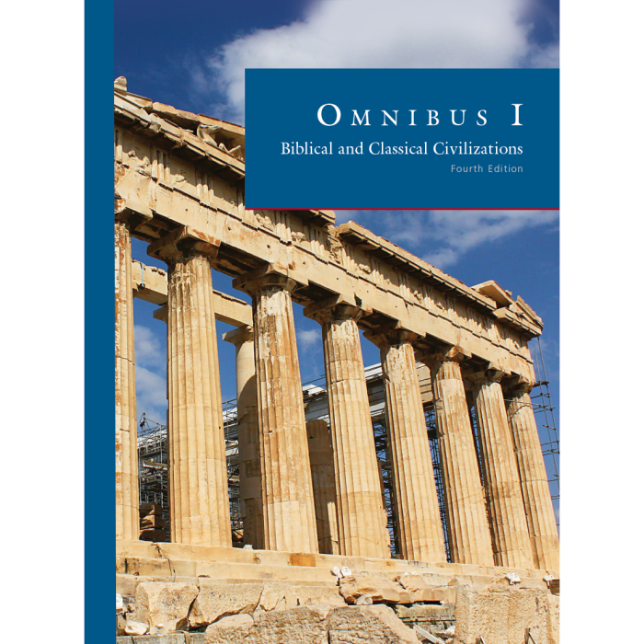
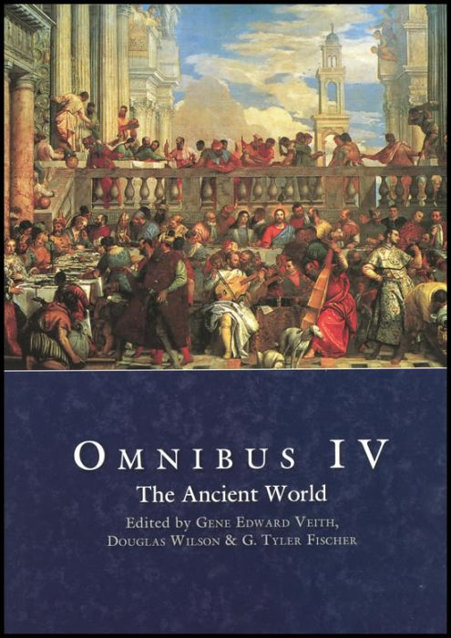
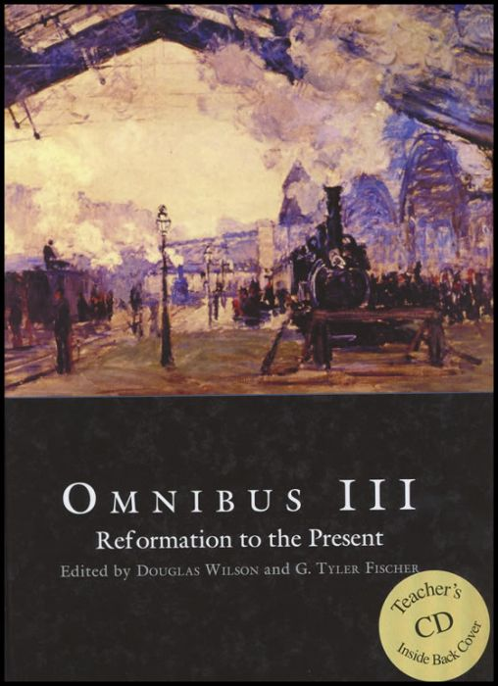
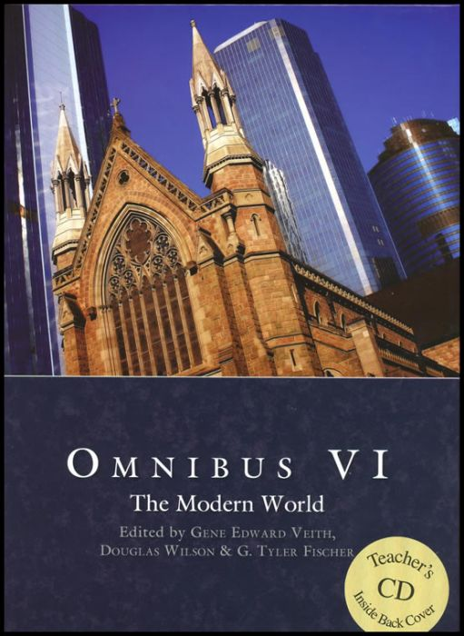
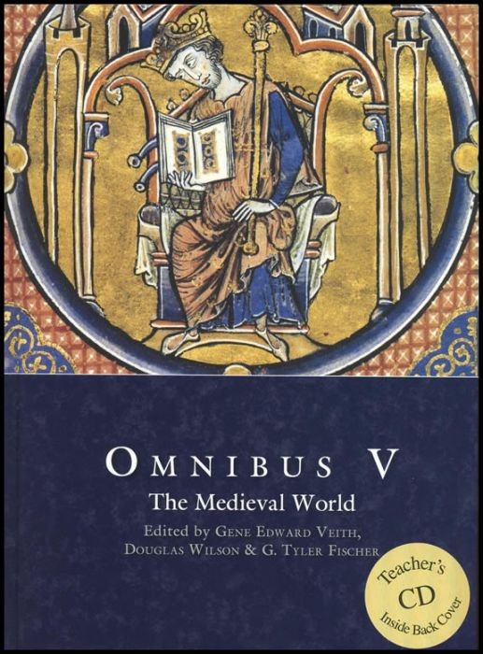
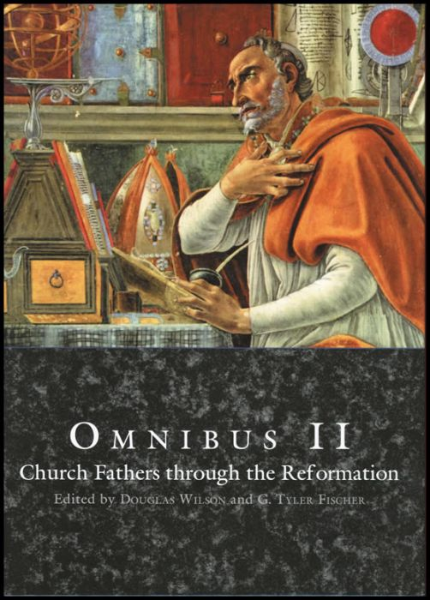
The best I could find for mine:
Douglas Wilson
G. Tyler Fischer
Gene Edward Veith
Douglas Wilson
G. Tyler Fischer
Notes:
Joined VP because Pre Wittenberg Academy (“Paideia” instead of “Omnibus”)
https://www.wittenbergacademy.org/

Slide 26
Omnibus II (grade 8)
Omnibus I (grade 7)
Beowulf | Heaney, translator
Bible, The | God
Bondage of the Will, The | Luther
Canterbury Tales, The | Chaucer
Confessions | Augustine
Divine Comedy, The: Book I, "Inferno" | Dante
Ecclesiastical History of the English People | Bede
Church History, The | Eusebius
History of the Kings of Britain | Geoffrey of Monmouth
Macbeth | Shakespeare
On the Incarnation of Our Lord | Athanasius
Rule of St Benedict | Fry, translator
Sir Gawain and the Green Knight | Tolkien, translator
Song of Roland, The | Sayers, translator
Dragon and the Raven, The | Henty
Henry V | Shakespeare
Hobbit, The | Tolkien
King Richard III | Shakespeare
Lord of the Rings, The, Volumes I-III | Tolkien
Merry Adventures of Robin Hood, The | Pyle
A Midsummer Night's Dream | Shakespeare
Nine Tailors, The | Sayers
Winning His Spurs: A Story of the Crusades | Henty
Aeneid, The | Virgil
Codes of Hammurabi and Moses | Davies, compiler
Early History of Rome, Books I-V | Livy
Gilgamesh | Ferry, translator
Julius Caesar | Shakespeare
Histories, The | Herodotus
Last Days of Socrates, The | Plato
Odyssey, The | Homer
Oresteia Trilogy | Aeschylus
Lives: Volume I (exerpts) | Plutarch
Theban Trilogy | Sophocles
Twelve Caesars, The | Suetonius
Bible, The | God
Best Things in Life, The | Kreeft
Chosen by God | Sproul, RC
Chronicles of Narnia: Volumes 1-7 | Lewis, CS
Eagle of the Ninth, The | Sutcliff
Holiness of God, The | Sproul, RC
Screwtape Letters, The | Lewis, CS
Till We Have Faces | Lewis, CS
Unaborted Socrates, The | Kreeft
Notes:
Omnibus I, IV

Slide 27
Omnibus III (grade 9)
Nineteen Eighty-Four (1984) | Orwell
Abraham Lincoln: Speeches and Writings | Fehrenbacher, editor
Anti-Federalist Papers, The | Ketcham, compiler
Bible, The | God
Communist Manifesto, The | Marx and Engels
Federalist Papers, The | Hamilton, Madison and Jay
Great Gatsby, The | Fitzgerald
Mein Kampf | Hitler
Of Plymouth Plantation | Bradford
Pilgrim's Progress, The | Bunyan
Reflections on the Revolution in France | Burke
Social Contract, The | Rousseau
Tale of Two Cities | Dickens
Uncle Tom's Cabin | Stowe
Constitution of the United States, The
Declaration of Independence, The | Jefferson
Articles of Confederation
Treaty of Versailles, The
Pit and the Pendulum, The | Poe
Adventures of Tom Sawyer, The | Twain
Animal Farm | Orwell
Autobiography of Charles G. Finney, The | Finney
Benjamin Franklin: Autobiography &… | Franklin
Christianity and Liberalism | Machen
Death of a Salesman | Miller
Frankenstein | Shelley
Gulliver's Travels | Swift
How Should We Then Live? | Schaeffer
Killer Angels, The | Shaara
Little Women | Alcott
Foxe's Book of Martyrs, The [New] | Foxe
Old Man and the Sea | Hemingway
Postmodern Times | Veith
Pride and Prejudice | Austen
Notes:
Omnibus II, V

Slide 28
Omnibus IV (grade 10)
Annals of Imperial Rome, The | Tacitus
Apostolic Fathers | Lightfoot and Harmer, ed.
Bacchae, The | Euripides
Bible, The | God
Cicero: Selected Works (selections) | Grant, translator
Eclogues and Georgics | Virgil
Iliad, The | Homer
Nicomachean Ethics | Aristotle
Poetics | Aristotle
Josephus, the Essential Writings, "The Jewish War" | Maier, translator
Peloponnesian War, The | Thucydides
Clouds, The | Aristophanes
Meditations | Aurelius
Metamorphoses | Ovid
Apocrypha, The
On the Nature of Things | Lucretius
Republic, The | Plato
Elements (excerpts) | Euclid
War with Hannibal, The | Livy
Aesop's Fables | Zipes, editor
Antony and Cleopatra | Shakespeare
Art and the Bible | Schaeffer
Augustus Caesar's World | Foster
Death on the Nile | Christie
Desiring God | Piper
Knowing God | Packer
Lost World, The | Doyle
Mythology | Hamilton
Phantastes | MacDonald
Lives: Volume II (excerpts) | Plutarch
Troiles and Cressida | Shakespeare
Twenty Thousand Leagues Under the Sea | Verne
Notes:
Omnibus II, V

Slide 29
Omnibus V (grade 11)
Bible, The | God
City of God, The | Augustine
Consolation of Philosophy, The | Boethius
Divine Comedy, The: Book II "Purgatory", Book III "Paradise" | Dante
Fierce Wars and Faithful Loves | Spenser
Institutes of the Christian Religion | Calvin
Introduction to St Thomas Aquinas (selections) | Aquinas
Lives of Thomas Becket, The | Staunton
Martin Luther: collections from his writings (selections) | Dillenberger, editor
Praise of Folly, The | Erasmus
Prince, The | Machiavelli
Romeo and Juliet | Shakespeare
Two Lives of Charlemagne | Einhard and Notker, the Stammerer
Chronicle of the Kings of England | William of Malmesbury
Connecticut Yankee in King Arthur's Court, A | Twain
Decameron, The | Boccaccio
Distant Mirror, A | Tuchman
Don Quixote | Cervantes
George Herbert: The Complete English Poems (selections) | Herbert
Great Divorce, The | Lewis, CS
Heidelberg Catechism | Williamson, compiler
Here I Stand: A Life of Martin Luther | Bainton
Idylls of the King | Tennyson
Le Morte D 'Arthur | Malory
Name of the Rose, The | Eco
Othello | Shakespeare
Saga of the Volsungs, The: Norse Epic of Sigurd the Dragon Slayer | Byock
St. Thomas Aquinas and St. Francis of Assisi | Chesterton
Tartuffe | Moliere
Travels of Marco Polo, The | Lathan, translator
Notes:
Omnibus II, V

Slide 30
Robinson Crusoe | Defoe
Stranger, The | Camus
Sun Also Rises, The | Hemingway
Wealth of Nations | Adam Smith
Fifty (50) Great Short Stories, The (selections) | Crane, Milton, editor; Forster, Hemingway, Maugham, O’Connor, Porter, Thurber
"The Wasteland" & "Ash Wednesday" | Elliot, TS
Common Sense | Paine
Guns of August, The | Tuchman
Hamlet | Shakespeare
Heart of Darkness | Conrad
Interpretation of Dreams | Freud
John Adams | McCullough
Jungle, The | Sinclair
Leaves of Grass, "Song of Myself" and "Drum Taps" | Whitman
On Christian Doctrine | Augustine
Out of the Silent Planet | Lewis, CS
Perelandra | Lewis, CS
That Hideous Strength | Lewis, CS
Picture of Dorian Gray, The | Wilde
Red Badge of Courage, The | Crane, Stephen
Self-Reliance | Emerson
Strange Case of Dr. Jekyll and Mr. Hyde, The | Stevenson
Civil Disobedience | Thoreau
Legend of Sleepy Hollow | Irving
Omnibus VI (grade 12)
All Quiet on the Western Front | Remarque
Battle Cry of Freedom (excerpts) | Mcpherson
Beyond Good and Evil | Nietzsche
Bible, The | God
Brave New World | Huxley
Citizen Soldiers (excerpts) | Ambrose
Democracy in America (excerpts) | de Tocqueville
Emma | Austen
Adventures of Huckleberry Finn | Twain
I Have a Dream & Letter from Birmingham Jail | King, ML
Leviathan (excerpts) | Hobbes
Moby-Dick | Melville
Notes from Underground | Dostoyevsky
One Day in the Life of Ivan Denisovich | Solzhenitsyn
Origin and Principles of the American Revolution, The | von Gentz, John Quincy Adams, transl.
Paradise Lost | Milton
Pensees | Pascal
Portable Enlightenment Reader, The (selections) | Kramnick, editor Bacon, Descartes, Dumarsais, Franklin, Jefferson, Kant, la Mettre, Newton, Paine, Priestly, Voltaire
Notes:
Omnibus II, V

Slide 31


Surely, Christian teachers at Christian schools would want Christian textbooks?
Objection #2
“Many Christian publishers promote non-Lutheran theology so it’s better to use secular textbooks and thereby avoid theological conflict.”
$$TWO$$
Notes:
‘take two’ : VSA education is not for everyone; what of the more conventional approach?

Slide 32


Surely, Christian teachers at Christian schools would want Christian textbooks?
Objection #2
“Many Christian publishers promote non-Lutheran theology so it’s better to use secular textbooks and thereby avoid theological conflict.”
©1999
Notes:
One subject, grades school only, outdated

Slide 33


Surely, Christian teachers at Christian schools would want Christian textbooks?
Notes:
sample of textbook to illustrate the problem of trying to fix secular textbooks: The Geologic Time Scale
In the medieval European university the seven liberal arts were grammar, rhetoric, and logic (the trivium) and geometry, arithmetic, music, and astronomy (the quadrivium).
Public Domain: Philosophia et septem artes liberales, the seven liberal arts. From the Hortus deliciarum of Herrad of Landsberg (12th century)

Slide 34
Surely, Christian teachers at Christian schools would want Christian textbooks?
Notes:
Include sample of textbook to illustrate the problem of trying to fix secular books: The Geologic Time Scale
In the medieval European university the seven liberal arts were grammar, rhetoric, and logic (the trivium) and geometry, arithmetic, music, and astronomy (the quadrivium).
Public Domain: Philosophia et septem artes liberales, the seven liberal arts. From the Hortus deliciarum of Herrad of Landsberg (12th century)

Slide 35
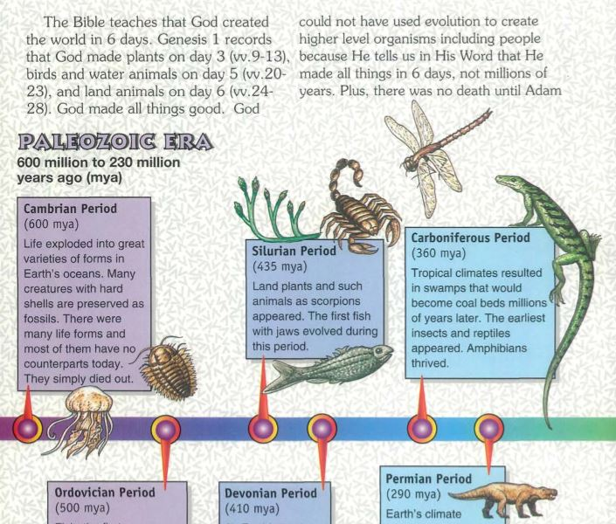
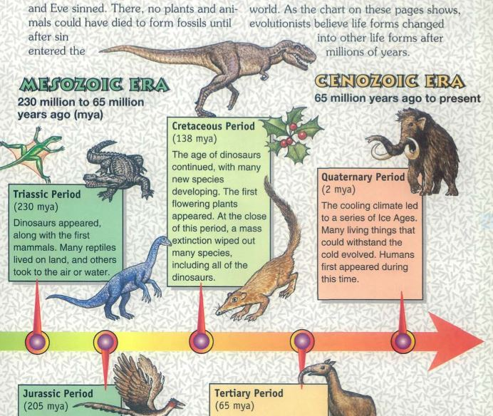
Surely, Christian teachers at Christian schools would want Christian textbooks?
Notes:
Include sample of textbook to illustrate the problem of trying to fix secular books: TheGeologic Time Scale
In the medieval European university the seven liberal arts were grammar, rhetoric, and logic (the trivium) and geometry, arithmetic, music, and astronomy (the quadrivium).
Public Domain: Philosophia et septem artes liberales, the seven liberal arts. From the Hortus deliciarum of Herrad of Landsberg (12th century)

Slide 36
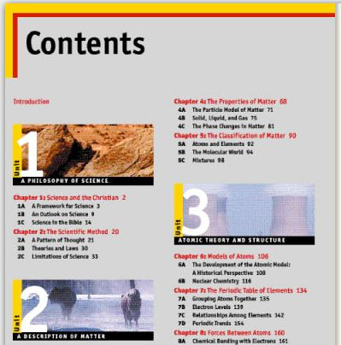

Surely, Christian teachers at Christian schools would want Christian textbooks?

Slide 37
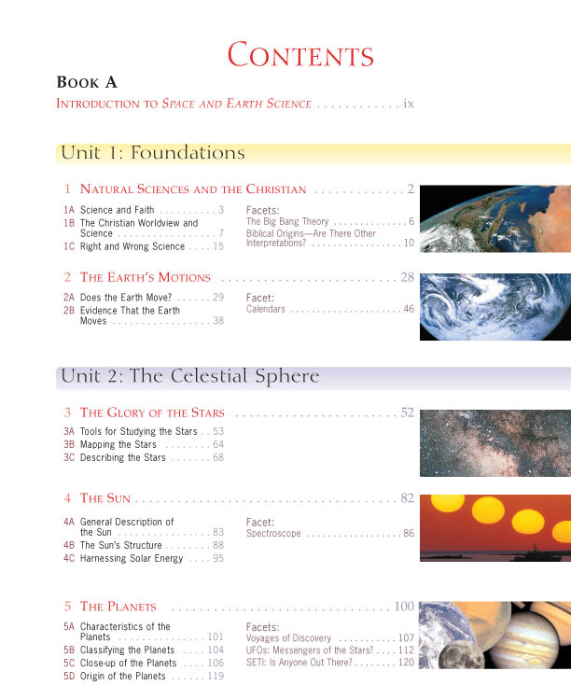

Surely, Christian teachers at Christian schools would want Christian textbooks?

Slide 38
Surely, Christian teachers at Christian schools would want Christian textbooks?
Objection #3:
“The Christian publisher recommended is associated with an institution that has had some questionable policies in the past, making the use of this publisher potentially offensive to some of our families.”
Notes:
Hiding behind this objection?

Slide 39
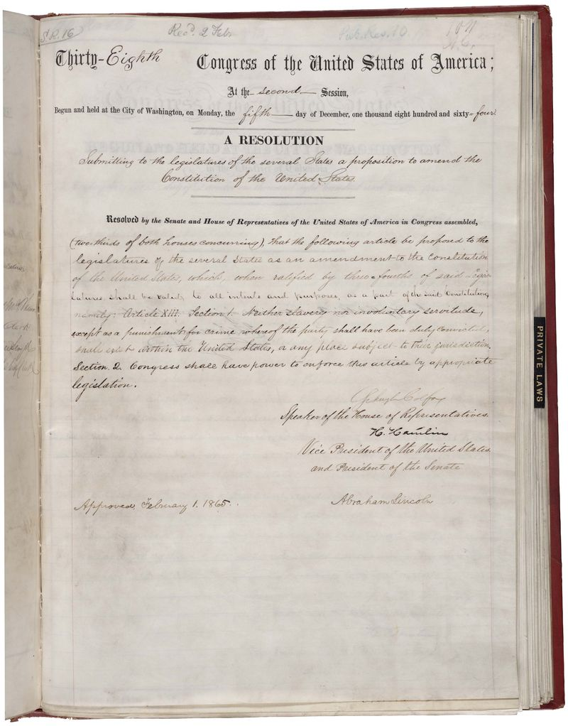
Surely, Christian teachers at Christian schools would want Christian textbooks?
“Neither slavery nor involuntary servitude, except as a punishment for crime whereof the party shall have been duly convicted, shall exist within the United States, or any place subject to their jurisdiction.”
Notes:
Image is Public Domain: Amendment XIII in the National Archives bearing the signature of Abraham Lincoln. Passed January 1, 1865.

Slide 40




Surely, Christian teachers at Christian schools would want Christian textbooks?
Objection #4:
“Who needs textbooks at all?”

Slide 41
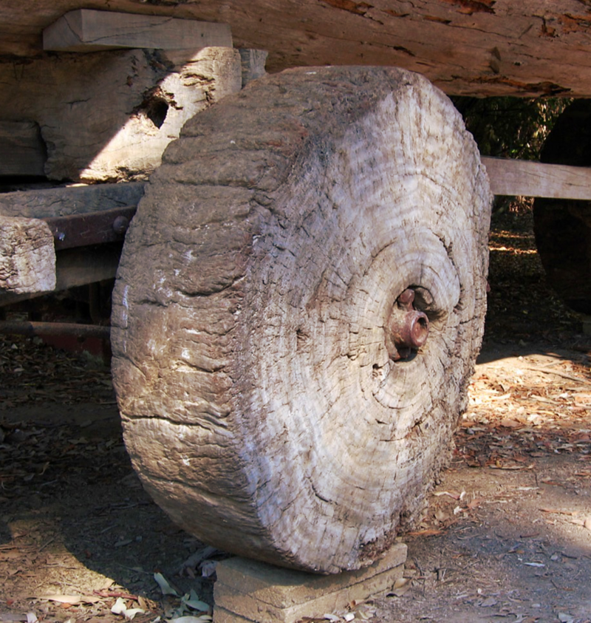
Surely, Christian teachers at Christian schools would want Christian textbooks?
…so, every teacher has to invent the wheel?

Slide 42
Surely, Christian teachers at Christian schools would want Christian textbooks?
Unspoken Objection:
“I am a theistic evolutionist so naturally I do not want Christian textbooks that affirm a six-day recent creation, but I won’t admit this. Let’s see… which objection will I adopt?”
Notes:
Pun - Haha

Slide 43
Of Creation
We teach that God has created heaven and earth, and that in the manner and in the space of time recorded in the Holy Scriptures, especially Gen. 1 and 2, namely, by His almighty creative word, and in six days. We reject every doctrine which denies or limits the work of creation as taught in Scripture. In our days it is denied or limited by those who assert, ostensibly in deference to science, that the world came into existence through a process of evolution; that is, that it has, in immense periods of time, developed more or less of itself. Since no man was present when it pleased God to create the world, we must look for a reliable account of creation to God's own record, found in God's own book, the Bible. We accept God's own record with full confidence and confess with Luther's Catechism: "I believe that God has made me and all creatures."
https://www.lcms.org/about/beliefs/doctrine/brief-statement-of-lcms-doctrinal-position#creation
Notes:
https://www.lcms.org/about/beliefs/doctrine/brief-statement-of-lcms-doctrinal-position#creation

Slide 44
From Luther’s Lectures on Genesis
“We assert that Moses spoke in the literal sense, not allegorically or figuratively; i.e., that the world with all its creatures was created within six days, as the words read.”
Martin Luther (1529)
by Lucas Cranach the Elder
Notes:
[1] Martin Luther, Lectures on Genesis: Chapters 1-5. In Luther’s Works. St. Louis: CPH, 1958, p. 5.

Slide 45
What subjects are affected by Creation doctrine?
Health; i.e., Sex Education
  Colorado HB19 1032 – ‘healthy relationships’ are defined by the state; validation of abortion is mandated where ‘pregnancy outcomes’ are taught
Biology; Earth & Space Science
Ancient History; Social Studies
Government
  “We hold these truths to be self-evident, that all men are created equal, that they are endowed by their Creator with certain unalienable rights.”
Psychology
Grammar (pronoun confusion)
Literature (by omission!)
What about those “neutral” subjects, like math?
Notes:
Colorado HB19 1032 Concerning Comprehensive Human Sexuality Education
Problems include mandate that abortion be presented as an ‘equal’ option as life, if pregnancy outcomes are covered; that abstinence as primary or sole acceptable preventative method cannot be taught. Also, ‘age appropriateness’ of the curriculum is vague and actual content is undefined. Also, ‘healthy relationships’ is defined by the state, not parent.

Slide 46




NOT
What subjects are affected by Creation doctrine?
^

Slide 47
A Riddle To Solve:
What organization has multiple universities full of expertise across many disciplines, including education, with Christian (Lutheran) faculty who could surely author and edit good and godly creation textbooks without problematic doctrine? What organization also has Concordia Publishing House to generate and distribute these textbooks? And, what organization also has its own grade schools and high schools to provide a market base?
The Lutheran Church – Missouri Synod !
Notes:
Apologia, BJUP, VP, Memoria Press, Abeka, etc. …and CPH? (Make them HARDBACK, please. Haha.)
Dr. Wile holds an earned Ph.D. in nuclear chemistry and has received more than $200,000 in research grants from the National Science Foundation. Those grants led to discoveries that have been published in the peer-reviewed journals of his field. He is also an adjunct professor at Anderson University in Anderson, Indiana. However, he is best know for his award-winning K-12 science curricula, primarily used by home-educated students. You can find his curriculum at: http://www.bereanbuilders.com

Slide 48
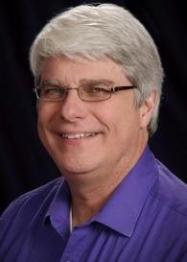
Riddle Solved: The LC-MS
What organization has multiple universities full of expertise across many disciplines including education with Christian (Lutheran) faculty who could surely author and edit good and godly creation textbooks without problematic doctrine? What organization also has Concordia Publishing House to generate and distribute these textbooks? And, what organization also has its own grade schools and high schools to provide a market base?
An example of the potential impact is found in Dr. Jay Wile:
Notes:
Apologia, BJUP, VP, Memoria Press, Abeka, etc. …and CPH? (Make them HARDBACK, please. Haha.)
Anderson University is an private Christian liberal arts university in Anderson, Indiana. The college is affiliated with the Church of God. Anderson University is a member of the Council for Christian Colleges and Universities, and the Independent Colleges of Indiana society.
Dr. Wile holds an earned Ph.D. in nuclear chemistry and has received more than $200,000 in research grants from the National Science Foundation. Those grants led to discoveries that have been published in the peer-reviewed journals of his field. He is also an adjunct professor at Anderson University in Anderson, Indiana. However, he is best know for his award-winning K-12 science curricula, primarily used by home-educated students. You can find his curriculum at: http://www.bereanbuilders.com

Slide 49

Of What Are We Afraid?
Government?
The Lord is my light and my salvation; whom shall I fear? The Lord is the stronghold of my life; of whom shall I be afraid? Ps. 27:1
Notes:
Afraid government will take away our schools? Threat is still there but more subtle: pizza example from St. Mark where government control comes through government monies: not just ‘no seconds’ on (pepperoni) pizza but requirements on using government approved “health” (sex ed) curriculum. Scary thought.
The Lord is my light and my salvation; whom shall I fear? The Lord is the stronghold of my life; of whom shall I be afraid?
Ps. 27:1 (ESV)

Slide 50
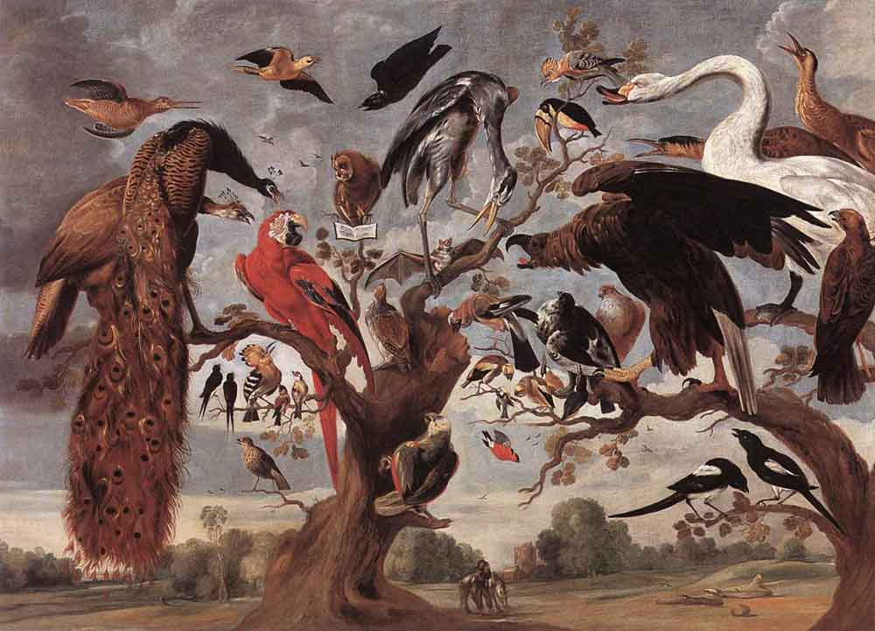
Of What Are We Afraid?
Government?
Academia?
The Mockery of the Owl Jan van Kessel the Elder
The Lord is my light and my salvation; whom shall I fear? The Lord is the stronghold of my life; of whom shall I be afraid? Ps. 27:1
Notes:
Romans 1:16: For I am not ashamed of the gospel, for it is the power of God for salvation to everyone who believes, to the Jew first and also to the Greek.
Matthew 10 (ESV)
³² So everyone who acknowledges me before men, I also will acknowledge before my Father who is in heaven, ³³ but whoever denies me before men, I also will deny before my Father who is in heaven.
The Mockery of the Owl a seventeenth-century painting by Jan van Kessel the Elder, loosely depicting a scene from the thirteenth-century Middle English poem, The Owl and the Nightingale, in which the owl is mocked for its characteristics by other birds.

Slide 51
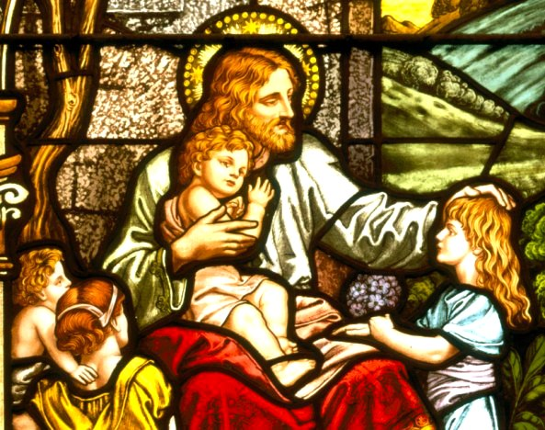
Of What Are We Afraid?
Government?
Academia?
Losing our Children!
The Lord is my light and my salvation; whom shall I fear? The Lord is the stronghold of my life; of whom shall I be afraid? Ps. 27:1
Notes:
https://www.jesus-story.net/jesus-children/

Slide 52
The foot that got in…
…an unexpected debate in the lunchroom
Notes:
Caveat: Tenure (or effective tenure) means you get stuck with Materialism’s foot! My experience with such a foot…

