Slide 1

Overture to Affirm and Bind Ourselves to the Biblical Doctrine of the Young Age of the Earth
RMD Pastors Conference
Trinity Lutheran Church
16 October 2020
In the Beginning, God…
Notes:
Notice name of overture:
“Bind ourselves” to Biblical Doctrine,
NOT make new doctrine!

Slide 2
The Denver Society of Creation strongly supports this overture passed by the Rocky Mountain Pastor’s Conference!
In the Beginning, God…

Slide 3
Attendance at Religious Services by Generation
Generation | % Attending
Greatest Generation (born before 1928) | 56%
Silent (born 1928 – 1945) | 44%
Boomer (born 1946 – 1964) | 32%
Gen X (born 1965-1980) | 27%
Millennial (born after 1980) | 18%
Pew Research Center, “Religion Among the Millennials”, February, 2010
Notes:
Why is the age of the earth important?

Slide 4
The Exodus of Our Youth
Six independent studies have confirmed that over 60% of youth are leaving the church. The main reasons for this exodus include:
  Christianity is shallow and too exclusive
  The church appears to be anti-science
  Learning about evolution in college
  Lack of specific or scientific evidence for a creator
  College is a hostile environment towards Christianity
  The teaching of moral relativism
Studies include: Pew Research, Nehemiah Institute, Barna Group, Lifeway Research, Answers in Genesis and Americas Research Group and the Public Religion Research Institute

Slide 5
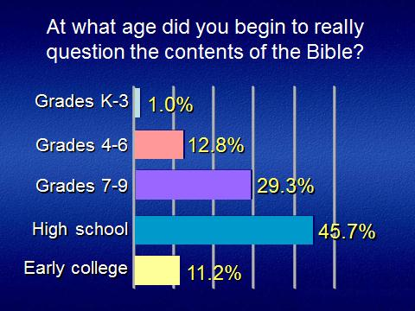
Notes:
Ken Ham and Britt Beemer with Todd Hillard, “Already Gone,” May 2009, Master Books, Green Forest, AR, p.176

Slide 6
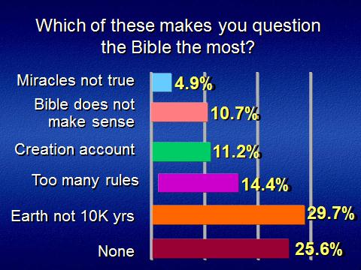
Notes:
Ken Ham and Britt Beemer with Todd Hillard, “Already Gone,” May 2009, Master Books, Green Forest, AR, p.178

Slide 7
2019 LCMS Synod Resolution
Creation in Six Natural Days
  Eliminated Gap Theory
  Eliminated Day Age Theory
Did not include a definitive statement on the age of the earth
Where else can “deep time” be “inserted” into the Bible?
Notes:
In order to reconcile the Bible’s history with evolution, you have to add long periods of time into the Bible.
Gap Theory – gap between Genesis 1:1 and Genesis 1:2
Day Age Theory (Progressive Creation) - Each day is a long period of time.

Slide 8
Genesis 5 Geneologies
Genesis 5 Chronogenealogy
Adam 930
Seth 912
Enosh 905
Cainan 910
Mahalalel 895
Jared 962
Enoch 365
Methuselah 969
Lamech 777
Noah 950
130 800
105 807
90 815
70 840
65 830
162 800
65 300
187 782
182 595
502* 448 (Shem)
Total
1558
Notes:
Other genealogies are found in 1 Chronicles 1 and Luke 3.
1 Chronicles 1 has the same patriarchs in the same order as Genesis 5 and 11
Luke adds Cainan which we will talk about later.
Only Genesis 5 and 11 genealogies include the age of the father at the birth of his descendant. These are called Chronogenealogies.
They also include a “checksum” to ensure they are copied correctly.
A pattern of father/son is established; however, even if it’s not father/son, we still know the number of years between generations.
*Gen 5:32 - After Noah was 500 he fathered Shem, Ham and Japheth. This may mean that Japheth, not Shem, was the oldest, since Shem fathered Arpachshad two years after the flood (Gen 11:10) and was 100 at the time. (Gen 11:10.)
[Gen 8:13-14 “In the six hundred and first year, in the first month, the first day of the month, the waters were dried from off the earth. … In the second month on the twenty-seventh day of the month, the earth had dried out.” Gen 9:28 “ After the flood, Noah lived 350 years.]

Slide 9
Genesis 5 Geneologies
Genesis 11 Chronogenealogy
Shem 600
Arpachshad 438
Shelah 433
Eber 464
Peleg 239
Reu 239
Serug 230
Nahor 148
Terah 205
100 500
35 403
30 403
34 430
30 209
32 207
30 200
29 119
>=130* 75 (Abram)
Total
450
Notes:
Terah was 70 per Genesis 11:26 when he Fathered Abram, Nahor and Haran. Abram was not the oldest, since per Genesis 11:32, Terah lived 205 years and died in Haran, and Abram was 75 when he departed from Haran per Genesis 12:4, and left soon after Terah’s death (Gen 12:1).
Doing the math, the youngest Terah could have been when he fathered Abraham was 130.

Slide 10
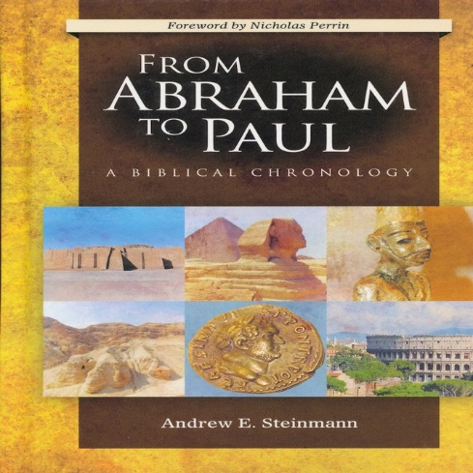
About
Today Jesus
2,000
Jesus Abraham
2,000
Abraham Adam
2,000
About
6,000
Notes:
How do we get to the years from Abraham to Today? Does the Bible tell us? NO! We have to add up years from the text of the Bible.
Adding up the Genesis 5 and 11 genealogies is no different.
If the Bible told us directly, it would always be wrong!

Slide 11
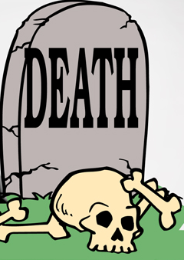
Literal Interpretation
The Fall (Sin)
Creation
6 Days (Perfect)
Romans 5:12 Therefore, just as
through one man sin entered
the world, and death through sin,
and thus death spread to all men,
because all sinned.

Slide 12
Millions of Years
The Fall (Sin)
Creation
Millions of Years
?
No Effect
Adam Eve

Slide 13
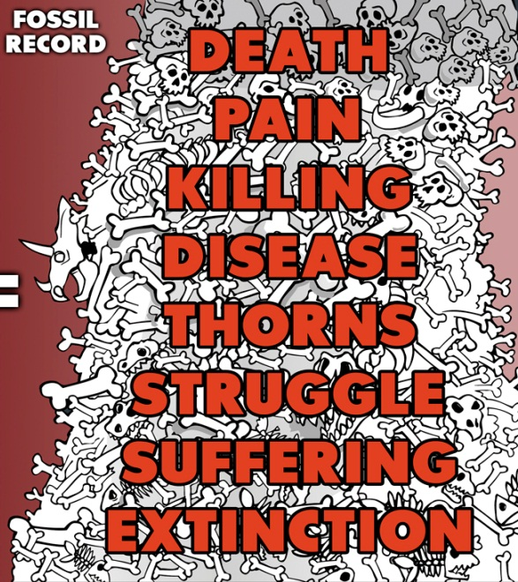

Character of God
Genesis 1:31
And God saw every thing that he had made, and, behold, it was very good. And the evening and the morning were the sixth day.
Very Good
Perfect No death
?
Notes:
The current challenge is the age of the earth.
Next challenge: Were Adam and Eve Real Historical Individuals?

Slide 14

Mark 10:6
But from the beginning of creation, God made them male and female.
Notes:
Adam and Eve at the “beginning” of creation.

Slide 15
Does It Matter What we Believe About Adam & Eve?
“The most devastating thing, though,that biology did to Christianity was the discovery of biological evolution. Now that we know that Adam and Eve never were real people, the central myth of Christianity is destroyed. If there never was an Adam and Eve, there never was an original sin. If there never was an original sin, there is no need of a savior. And I submit that puts Jesus, historical or otherwise, into the ranks of the unemployed. I think that evolution is absolutely the death knell of Christianity.”
Frank Zindler, American atheist, in a debate with William Lane Craig,, Atheism vs. Christianity video, Zondervan, 1996
Notes:
Atheists certainly seem to think it is!
Frank Zindler knew that William Lane Craig was a theistic evolutionist.
Sadly, most of the debate about Adam and Eve’s historicity is coming from inside the church
Intellectuals in the church are propagating this in our universities and seminaries.
The vast majority of Christian colleges don’t actually believe in a literal Adam and Eve.
Almost all seminaries teach against a literal Adam & Eve
BioLogos was created exactly for that purpose.
“Go To” scientist at BioLogos is Dennis Venema who recently wrote a book, “Adam & the Genome: Reading Scripture After Genetic Science” (All of his arguments have been falsified, but the book is still out there, devastating the faith of many.)
From John Sanford, 2018 ICC , “Defending Adam and Eve”

Slide 16

The Authority of Scripture
The attack on the age of the earth and the historical Adam & Eve is really an attack on the authority of God’s Word.
This Photo by Unknown Author is licensed under CC BY-NC-ND

Slide 17
LCMS Statements on the Age of the Earth
1932 Brief Statement:
“…
We reject every doctrine which denies or limits the work of creation as taught in Scripture. In our days it is denied or limited by those who assert, ostensibly in deference to science that the world came into existence through a process of evolution; that is, that it has, in immense periods of time, developed more or less of itself. Since no man was present when it pleased God to create the world, we must look for a reliable account of creation to God’s own record, found in God’s own book, the Bible. We accept God’s own record with full confidence…”
Notes:
If we “accept God’s own record with full confidence…” why can’t we give a definitive age to the earth, or at least limits on its age?

Slide 18
Limits on the Age of the Earth
Factors which limit precision
  Implied precision (based on context)
  Calendar Systems
  Cultural differences in birthday conventions and counting age
  Rounding imprecision accumulates
  Rounding of ages
  Masoretic vs LXX vs Samaritan Pentateuch
Hardy and Carter, “The biblical minimum and maximum age of the earth,” Journal of Creation 28(2);89-96, August, 2014
Notes:
Article by Hardy and Carter assumes no gaps in the genealogies and looks strictly at ambiguities.

Slide 19
Limits on the Age of the Earth
Age of the Earth Using MT Gen 5 & 11 Genealogies
with No Gaps
Maximum Age
of the Earth
Numeric
Rounding
& Ambiguities
Septuagint
354 Years
1386 Years
6000 Years
7680
Years
Hardy and Carter, “The biblical minimum and maximum age of the earth,”
Journal of Creation 28(2);89-96, August, 2014
Notes:
Article by Hardy and Carter assumes no gaps in the genealogies and looks strictly at ambiguities.

Slide 20
Biblical Interpretation Factors
Possible gaps in Genesis 5 and 11 genealogies
  Meaning of Hebrew word for begat (yalad)
Presence of Cainan in Luke 3 genealogy
Notes:
My research indicates Dr. Andrew Steinmann is the leading LCMS authority on Genealogies.
“Gaps in the Genealogies in Genesis 5 and 11?” Bibliotheca Sacra 174 (April – June 2017) 141-58
“Genesis Genealogies and Messianic Promise” Bibliotheca Sacra 176 (July-September 2019) 343-59
Believes there are possible gaps, or at least, that it cannot be said that there are no gaps.
Steinmann’s evidence Genesis 5 & 11 Genealogies have possible gaps
Other OT genealogies have gaps (Other genealogies don’t have the number of years between generations.) Steinmann admits this doesn’t prove that Genesis 5 and 11 have gaps.
Jude 14 might just be reading Genesis 5. (Inspiration and inerrancy of scripture?)
“With Luther, we confess that “God’s Word cannot err” (LC, IV, 57). We therefore believe, teach and confess that since the Holy Scriptures are the Word of God, they contain no errors or contradictions but that they are in all parts and words the infallible truth. …”
[We reject] that statements of Jesus and the New Testament writers concerning the human authorship of portions of the Old Testament or the historicity of certain Old Testament persons and events need not be regarded as true (for example, the Davidic authorship of Psalm 110, the historicity of Jonah, or the fall of Adam and Eve.)”
The Infallibility of Scripture, “A Statement of Scriptural and Confessional Principles,” Resolution 3-01, 1973 Proceedings, pp 127-128.
Hebrew word for begat means to cause Seth performed an act which “caused” the “line of” Enosh at a later time. (Still have number of years between ancestor and descendant.) (Others indicate yalad never skips generations in any OT usage.)
Near eastern chronology does not agree with the Bible:
Egyptian Chronology (Egyptian chronology is well known to have inserted kings in order to make their culture older.)
We should not elevate external sources above the Bible.
“We affirm, however, that the Christian interpreter of Scripture cannot adopt uncritically the presuppositions and canons of the secular historian, but that he will be guided in his use of historical techniques by the presuppositions of his faith in the Lord of history, who reveals Himself in Holy Scripture as the one who creates, sustains, and even enters our history in order to lead it to His end.” ….
“[ We reject] That if the use of historical methods leads to conclusions at variance with the evident meaning of the Biblical text, sub conclusions may be accepted without violating the Lutheran view of Scripture or our commitment to the Lutheran Confessions…”
“A Statement of Scriptural and Confessional Principles”, (see above for reference)
Fuzzy and magic words (“possible” gaps)
If there are gaps, where are they?
Those who claim that there are gaps in these genealogies need to demonstrate this from the biblical text and not simply say that gaps exist. However, consider the following:
1. Although in the Hebrew way of thinking, the construction
"X is the son of Y'' does not always mean a literal father/son
relationship,5 additional biographical information in Genesis
5 and 11 strongly supports the view that there are no gaps
in these chapters. So we know for certain that the following
are literal father/son relationships: Adam/Seth, Seth/Enosh,
Lamech/Noah, Noah/Shem, Eber/Peleg, and Terah/Abram.
Nothing in these chapters indicates that the "X begat Y'' means
something other than a literal father/son relationship.
2. Nowhere in the Old Testament is the Hebrew word for begat
(.yalad) used in any other way than to mean a single-generation
(e.g., father/son or mother/daughter) relationship. The Hebrew
word ben can mean son or grandson, but the word yalad never
skips generations.

Slide 21
Meaning of the Begat (yalad)
Meaning of the Hebrew word for begat (yalad)
  “Nowhere in the Old Testament is the Hebrew word for begat (yalad) used in any other way than to mean a single-generation (e.g., father/son or mother/daughter) relationship”
  “The Hebrew word “ben” can mean son or grandson, but the word “yalad” never skips generations.”
Pierce and Ham, “Are there Gaps in the Genesis Genealogies?”
Notes:
“Hebrew Words Involved:
And even if we grant that Z is a descendant of X, Z is always preceded by the accusative particle 'et (nK), which is not translated but marks Z as the direct object of the verb 'begat' (wayyoled (171'1)). This means that the begetting of Z by X still occurred when X was Y years old, regardless of whether Z was a son or a more distant descendant. The Hebrew grammar provides further support-wG_Y.Yo/ed is the hiphil waw-consecutive imperfect form of the Hebrew verb ya/ad-the hiphil stem communicates the subject participating in action that causes an event, e.g. Seth as the begetter of Enosh.
Hasel pointed out:
The repeated phrase "and he fathered PN [personal name]" (wayyoled 'et-PN) appears fifteen times in the OT-all of them in Genesis 5 and 11. In two additional instances the names of three sons are provided (Genesis 5:32; 11 :26). The same verbal form as in this phrase (i.e., wG_Y.Yo/ed) is employed another sixteen times in the phrase "and he fathered (other) sons and daughters" (Genesis 5:4, 7, 10, etc.; 11:ll, 13, I 7, etc.). Remaining usages of this verbal form in the Hiphil in the book of Genesis reveal that the expression "and he fathered" ( wayyoled) is used in the sense of a direct physical offspring (Genesis 5:3; 6: l 0). A direct physical offspring is evident in each of the remaining usages of the Hiphil of wayyoled, "and he fathered", in the OT (Judges 11:l; 1 Chronicles 8:9; 14:3; 2 Chronicles 11:21; 13:21; 24:3). The same expression reappears twice in the genealogies in 1 Chronicles where the wording "and Abraham fathered Isaac" (1 Chronicles 1:34; cf. 5:37 [6:11]) rules out that the named son is but a distant descendant of the patriarch instead of a direct physical offspring. Thus the phrase "and he fathered PN" in Genesis 5 and I 1 cannot mean Adam "begat an ancestor of Seth." The view that Seth and any named son in Genesis 5 and 11 is but a distant descendant falters in view of the evidence of the Hebrew language used.40 “
Jonathan D. Sarfati, “The Genesis Account – A theological, historical, and scientific commentary on Genesis 1-11”, 2015, CMI, Powder Springs, GA, p.466

Slide 22
Meaning of Begat (yalad)
The most straightforward meaning of the word yalad is a father/son relationship.
However, some would say it means the beginning of a “line” of people which ends in the descendant.
  Methuselah… 1st descendant … 2nd descendent… Lamech
  Methuselah caused an act which 187 years later resulted in the line of Lamech.
  Lamech appeared sometime later.
Father/Son pattern has been established by Biblical context
Notes:
Interesting that Steinmann agrees with progressive creationist Hugh Ross on this point (“line”)!
“Hebrew Words Involved:
And even if we grant that Z is a descendant of X, Z is always preceded by the accusative particle 'et (nK), which is not translated but marks Z as the direct object of the verb 'begat' (wayyoled (171'1)). This means that the begetting of Z by X still occurred when X was Y years old, regardless of whether Z was a son or a more distant descendant. The Hebrew grammar provides further support-wG_Y.Yo/ed is the hiphil waw-consecutive imperfect form of the Hebrew verb ya/ad-the hiphil stem communicates the subject participating in action that causes an event, e.g. Seth as the begetter of Enosh.
Hasel pointed out:
The repeated phrase "and he fathered PN [personal name]" (wayyoled 'et-PN) appears fifteen times in the OT-all of them in Genesis 5 and 11. In two additional instances the names of three sons are provided (Genesis 5:32; 11 :26). The same verbal form as in this phrase (i.e., wG_Y.Yo/ed) is employed another sixteen times in the phrase "and he fathered (other) sons and daughters" (Genesis 5:4, 7, 10, etc.; 11:ll, 13, I 7, etc.). Remaining usages of this verbal form in the Hiphil in the book of Genesis reveal that the expression "and he fathered" ( wayyoled) is used in the sense of a direct physical offspring (Genesis 5:3; 6: l 0). A direct physical offspring is evident in each of the remaining usages of the Hiphil of wayyoled, "and he fathered", in the OT (Judges 11:l; 1 Chronicles 8:9; 14:3; 2 Chronicles 11:21; 13:21; 24:3). The same expression reappears twice in the genealogies in 1 Chronicles where the wording "and Abraham fathered Isaac" (1 Chronicles 1:34; cf. 5:37 [6:11]) rules out that the named son is but a distant descendant of the patriarch instead of a direct physical offspring. Thus the phrase "and he fathered PN" in Genesis 5 and I 1 cannot mean Adam "begat an ancestor of Seth." The view that Seth and any named son in Genesis 5 and 11 is but a distant descendant falters in view of the evidence of the Hebrew language used.40 “
Jonathan D. Sarfati, “The Genesis Account – A theological, historical, and scientific commentary on Genesis 1-11”, 2015, CMI, Powder Springs, GA, p.466

Slide 23

Genesis 5 Geneologies
Genesis 5 Genealogies – Where Are the Gaps?
Jude 14
130
105
90
70
65
162
65
187
182
502*
Seth
Jared
Enoch
Noah
Shem
Adam
Enosh
Cainan
Lamech
Mahalalel
Methuselah
Genesis5:32, 11:10, 8:13-14
Genesis 4:25
Genesis
is 4:26
Genesis5:28-29
1558 YEARS
Notes:
Seth is definitely a direct son of Adam and Eve, and seen as a replacement for Abel, killed by Cain (Genesis 4:25)
Enosh: Must be a son of Seth, because Seth named him (Gen 4:26)
Enoch: Jude 14 says Enoch was seventh from Adam, which indicates straightforward father-son relationships from Adam to Enoch.
Noah: Lamech named him, so Lamech must be his father, not just an ancestor (Gen 5:29)
Gen 5:32 - After Noah was 500 he fathered Shem, Ham and Japheth. This may mean Shem was not the oldest, since Shem fathered Arpachshad two years after the flood (Gen 11:10) and was 100 at the time. (Gen 11:10.)
[Gen 8:13-14 “In the six hundred and first year, in the first month, the first day of the month, the waters were dried from off the earth. … In the second month on the twenty-seventh day of the month, the earth had dried out.” Gen 9:28 “ After the flood, Noah lived 350 years.]

Slide 24
Genesis 5 Geneologies
Genesis 5 Genealogies – Where Are the Gaps?
Flood
Adam
Methuselah
969 Years
687 Years
187
Years
Lamech 777 Years
182
Years
Noah
600 Years
Enoch named his son Methuselah
Methuselah means “when he dies, it will be sent”
Oldest person ever to live – Died in the year of the flood
Lamech died within Methuselah’s lifetime
1656 YEARS
Notes:
Methuselah: Enoch, a pre-Flood prophet (Jude 14)
whose name means ‘dedicated,’
God took him, he is one of two people who did not die
gave his son(or descendant) a name meaning ‘when he dies, it shall be sent*,’
and the Masoretic chronology without any gaps would place his death in the year of the Flood. [Not in the flood. – Genesis 6:11 “In the six hundredth year of Noah’s life, in the second month, on the seventeenth day of the month, on that day all the fountains of the great deep burst forth, and the windows of the heavens were opened.”]
Noah: Lamech named him, so Lamech must be his father, not just an ancestor (Gen 5:29)
Lamech died 5 years before his father, Methuselah.
*Some would advocate other meanings for the name Methuselah such as “man of the spear”, but this is the most common translation.

Slide 25
Genesis 5 Geneologies
Genesis 5 Genealogies – Where Are the Gaps?
Jude 14
1 Chronicles 1:1-4 and Luke 3:36-38 show the same names in the same order.
130
105
90
70
65
162
65
187
182
502*
Seth
Jared
Enoch
Noah
Shem
Adam
Enosh
Cainan
Lamech
Mahalalel
Methuselah
Genesis5:32, 11:10, 8:13-14
Genesis 4:25
Genesis
is 4:26
Genesis5:28-29
1558 YEARS

Slide 26
Genesis 5 Gaps?
“Importantly, Jude 14 says that Enoch was ‘the seventh from Adam.’ This means there is no gap between Adam and Enoch. Methuselah died in the year of the Flood, and Lamech (who named his son Noah) died just prior to the Flood. This shows that gaps are not indicated prior to the Flood, when we might expect this to be the most likely period to have gaps. Instead we have additional Biblical evidence to support the continuity and lack of gaps.”
David DeWitt (Ph.D. Neurosciences, Chair of Biology and Chemistry Liberty University), Unraveling The Origins Controversy, 2015, p. 167.

Slide 27
Genesis 5 Geneologies
Genesis 11 Genealogies – Where are the Gaps?
1 Chronicles 1:24-27 shows the same names in the same order.
100
35
30
34
30
32
30
29
130*
Peleg
Reu
Serug
Terah
Shem
Eber
Nahor
Shelah
Abraham
Arpachshad
Genesis 10:22
Genesis 10:24
Genesis 10:24
Genesis 10:25
Genesis 11:27-31
450 Years
Notes:
Genesis 10:22: “The sons of Shem: Elam, Asshur, Arpachshad, Lud and Aram.”
Genesis 10:25: “To Eber were born two sons: the name of one was Peleg, for in his days the earth was divided, and his brother’s name was Joktan.”
Genesis 11:27-31 “Abram, Haran, and Nahor were Terah’s ordinary sons, since they were clearly a family group.
Genesis 10:24 backs up Genesis 11 - “Arpachshad fathered Shelah; and Shelah fathered Eber”
(This may be same word as Genesis 11 – yalad, but not sure.)
Established a pattern of father/son relationships. The Bible gives us no reason to believe that the remaining four were NOT father/son relationships.
Transition: Luke genealogy adds Cainan between Arpachshad and Shelah!

Slide 28
Biblical Interpretation Factors
Presence of Cainan in Luke 3 genealogy
    “…the oldest manuscript we have of Luke, the P75, was found. It dates to the late second century A.D. and does not include Cainan in the genealogy. This verse in Luke should not be used to prove that the genealogies in Genesis have gaps, because it has poor textual authority.”
    Pierce and Ham, “Are there Gaps in the Geneologies of Genesis 5 and 11?”
  I believe a careful examination of all of the extant ancient sources up to and including rabbinic writings and the Church Fathers demonstrates that Cainan was an early addition to the text of Luke which led to purposeful alteration of LXX.
  Andrew Steinmann, “Challenging the Authority of Cainan, Son of Arpachshad,” JETS 60/4 (2017): 697–71
Notes:
Steinmann agrees with Ham and Pierce and other scholars on the presence of Cainan in the Luke genealogy.
Dr. Jonathan Sarfati has ably refuted the claims of the open view proponents by mentioning the following facts concerning Cainan in Luke 3:36:3
The extra Cainan in Genesis 11 is found only in manuscripts of the LXX4 that were written long after Luke’s gospel. The oldest LXX manuscripts do not have this extra Cainan.
The earliest known extant copy of Luke omits the extra Cainan. This is the 102-page (originally 144) papyrus codex of the Bodmer Collection labeled P⁷⁵ (dated between A.D. 175 and 225).
Josephus used the LXX as his source, but did not mention the second Cainan.
Julius Africanus (c. A.D. 180 – c. 250) was “the first Christian historian known to have produced a universal chronology.” In his chronology, written in c. A.D. 220, he also followed the LXX ages but once again omitted this mysterious Cainan.
https://answersingenesis.org/bible-timeline/genealogy/are-there-gaps-in-the-genesis-genealogies/

Slide 29

Critical Thinking
Good hermeneutics dictates we use:
  The purpose of the communication (intent of the author)
    Intent of this genealogy seems to be to document the history or genealogies (toledoths) of the early world
    Preserve and document the line of the Messiah
    If it were only the line of the Messiah, why would the author include the time between ancestor and descendant? None of the other genealogies do.

Slide 30
Critical Thinking
In order to get to 10,000 years, 250 generations would need to be added into the four “possible” gaps in Genesis 11
Does it make sense that Moses, inspired by God, would make such a detailed Chronogenealogy and then leave out 250 generations?
Notes:
Assumes a generation every 40 years, which is generous.
Those who claim that there are gaps in these genealogies need to demonstrate this from the biblical text and not simply use fuzzy words say that gaps could “possibly” exist.

Slide 31
Critial Thinking
“.., if long-age interpretations had always been popular, then a case could be made for assuming that the Bible hints at this. But if they were absent until they became popular in ‘science’, it’s more likely that such interpretations were motivated by trying to reconcile the Bible with ‘science.’”
Johnathan Sarfati, The Genesis Account: A theological, historical, and scientific commentary on Genesis 1-11, CMI, 2015, Powder Springs, GA p.2
Notes:
Many famous scientist were Creationists and believed in a young earth:
Isaac Newton is perhaps the most famous.

Slide 32
Critical Thinking
1830 - Charles Lyell wrote “Principles of Geology”
1859 – Darwin wrote “Origin of the Species”
Prior to these works, there was no mention of long ages or gaps in the genealogies by either theologians or scientists
Notes:
Charles Lyell introduced long ages in geology.
(14 November 1797 – 22 February 1875)
Principles of Geology – 1830
Darwin based his theories on Lyell.
(February 12, 1809 - April 19, 1882)
On the Origin of the Species - 1859
Prior to this, no mention of long ages in the Bible.

Slide 33
Critical Thinking
“This gnat-straining and camel-swallowing way of reading the simple Hebrew verb “fathered” puts a gap between each of the patriarchs in Genesis 5 and 11 …Such a totally preposterous misreading of the text never occurred to anyone in the entire history of the Church before the late nineteenth century.”
James B. Jordan, “Creation in Six Days,” Canon Press, Moscow, ID, 1999, p 99

Slide 34
Critical Thinking
Good hermeneutics dictates we use:
  Context
    Scripture interprets scripture
    We have Biblical cross references that confirm father/son relationships
  The explicit constrains the implicit
    Straightforward reading unless otherwise indicated
    Pattern of father/son relationships
      No Biblical evidence that ‘yalad’ means ancestor rather than father (CAN does NOT mean ALWAYS)
    Specified number of years between father and son (with a checksum to prevent copying errors)
Notes:
It appears two patterns are being established:
Establishing a pattern of father/son.
Also, establishing a pattern of detailed chronogenealogy.

Slide 35
Dr. Andrew Steinmann on Long Ages
“Because evolutionary theory – and long age dogma – has become so widespread among scientists and so accepted in today’s world, many conservative biblical commentators have felt the need to somehow produce an explanation of Genesis’ creation account that can be seen as being in harmony with what much of the educated world now accepts as established fact. Such explanations, which try to accommodate the billions of years that many scientists believe were needed for evolution, inevitably do violence to the teaching of Scripture. These explanations not only deny the plain meaning of Genesis, but they also inevitably lead to denial of basic Christian doctrine, such as the atoning work of Christ. Moreover, they often require ungrammatical and unreasonable readings of the text of Genesis.”
Dr. Andrew Steinmann, “Hebrew professor: Genesis teaches six solar days!” Creation 36(1):48-51, January 2014
Notes:
In spite of raising the doubt of “possible” gaps in the genealogies, Steinmann still advocates for a young earth.

Slide 36
Dr. Andrew Steinmann on Gaps
“This [possible gaps in the genealogies of Genesis 5 and 11] does not, however, require an old earth that is millions or billions of years old. Instead, it simply argues that the earth is older than the 6000 years that can be obtained by a simple arithmetic calculation based on the Genesis 5 and 11 genealogies.”
Dr. Andrew Steinmann, Hebrew professor: ‘Gaps in the Genealogies of Genesis 5 and 11? ‘, Bibliotheca Sacra, April-June 2017
Notes:
Hiding since Steinmann did a recent interview on age of the earth and said it could be as much as 100,000 years.

Slide 37
Objection Based on Egyptian Chronology
  Did the Egyptian pyramids survive the flood?
    No signs of water damage
    They are on top of sedimentary layers containing fossils from the flood
  The “Patterns of Evidence” series of films shows that there is evidence for the Bible’s history in Egypt if you look in the right place.
  Even mainstream Egyptologists agree that the Egyptian dates are inflated (too old)?
  We should trust God’s word rather than fallable man’s word.
  Prayer News, Creation Ministries International, April 2020, Page 1
Notes:
“Skeptics often use Egypt as a focal point for attacking the Bible’s history, because they claim that we don’t see evidence for the Hebrews in Egypt or the Exodus, events that should have left a historical trace. They also point out that the early part of the standard Egyptian chronology predates the biblical date for the Flood, which would have destroyed any Egyptian artifacts.
The Patterns of Evidence series of films that CMI carries shows that there is evidence for the Bible’s history in Egypt if you look in the right place. And even mainstream Egyptologists agree that the dates are inflated (too old).” Gary Bates and Lita Cosner, “Evidence for the Bible’s history in Egypt,” Prayer News, Creation Ministries International, April 2020, Page 1

Slide 38
Scientific Evidence
There is NO scientific evidence which proves an old earth
  Radiometric dating is based on assumptions and does NOT prove an old earth.
There is significant evidence to affirm the Biblical age of the earth
  Soft tissue, red blood cells, and DNA in Dinosaurs
  Y Chromosome and Mitochondrial DNA
  Geologic evidence of a recent worldwide flood
  Mt. St. Helen’s eruption
  Many others
Notes:
No conflict between real observational science and the Bible.
Conflict is between evolution and the Bible.
Radiometric Dating Assumptions:
We know the amount of the parent and daughter elements when the rock formed.
The rate of decay was the same throughout the life of the rock.
It was a closed system. (No water or other elements entered or left.)

Slide 39
Where Do We Go from Here?
When our synod does not make a statement on the age of the earth, are we compromising God’s word simply to accommodate evolutionists?

Slide 40
We ask your support in getting this overture to your circuits and later to your districts!
Let your pastor know you support this overture!
Discuss this with your friends!
Attend circuit forums!
Use this video or slides to talk to your church!
Invite a DSOC speaker to come to your church!
Elect delegates to the District Convention who support
young earth creation!
7. Write leaders in the synod expressing your
support!
In the Beginning, God…

Slide 41


